Slide 1
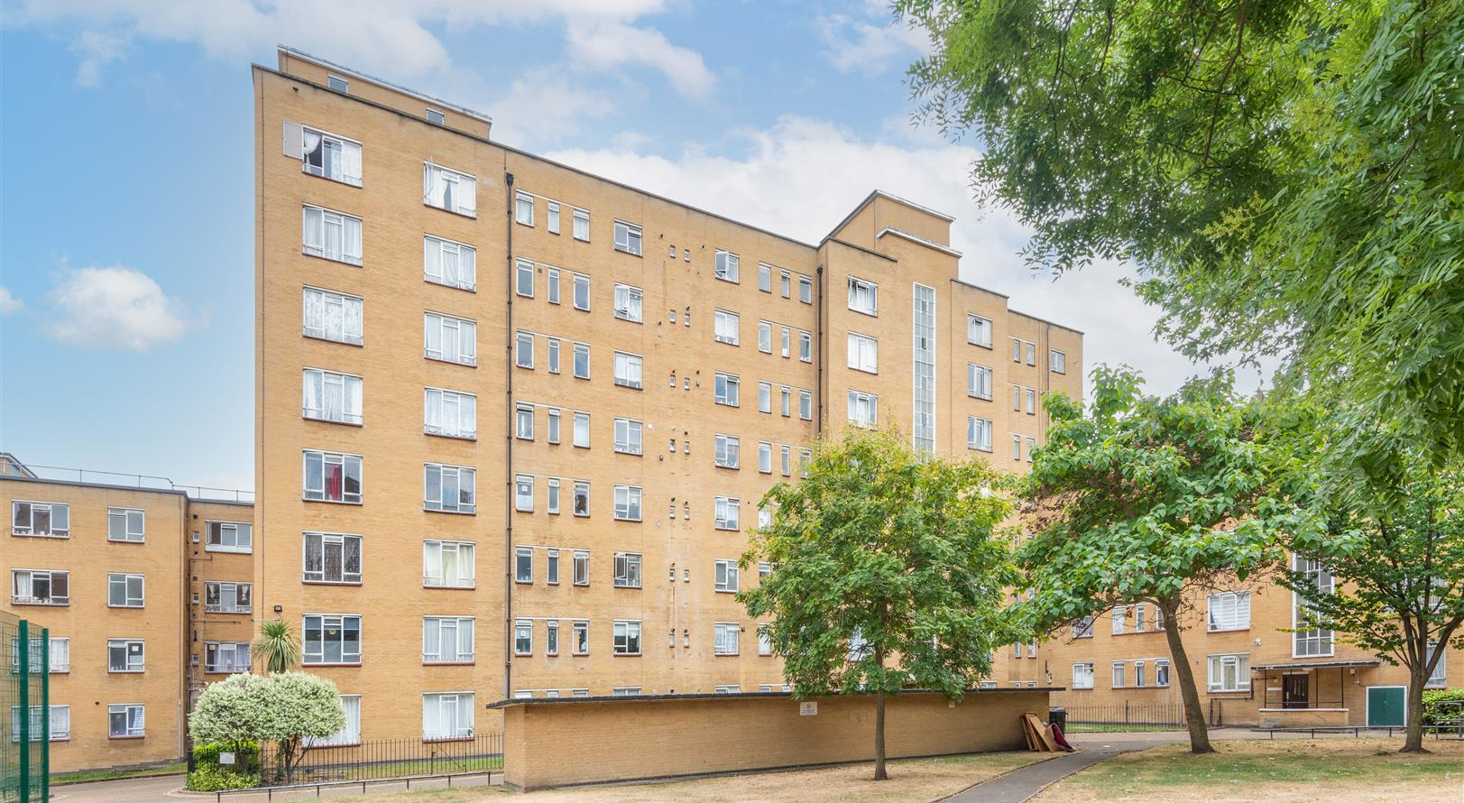

Y107
John Aird Court
Service Provider’s Proposals (SPP) Presentation
12th September 2024
Hallfield Presentation
26.06.2023
Marc Jeffrey

Slide 2

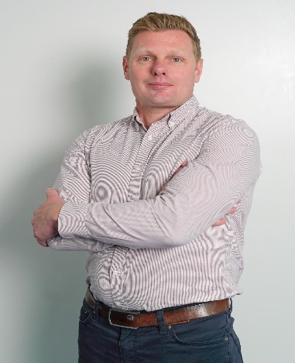
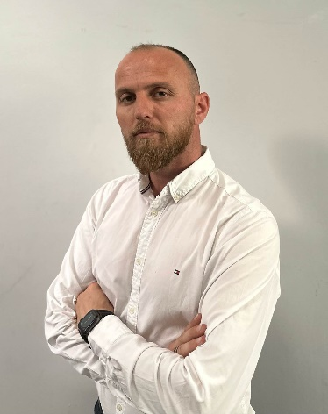
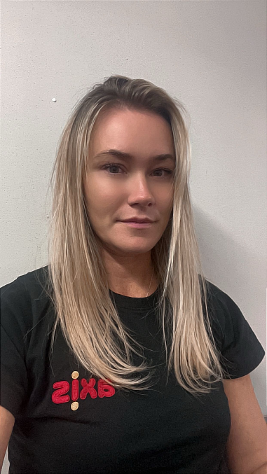
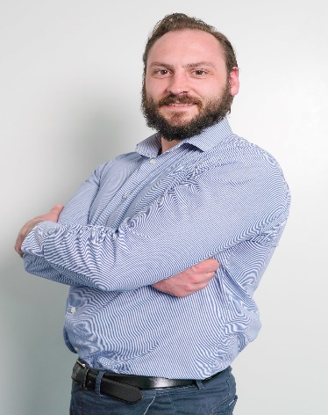
John Aird Court Y107
Marc Jeffrey
Project Director
Craig Roberts Divisonal Manager
Eric Sejat
Contracts Manager
Lindsey Gibbons Senior RLO
Daniel Sams Pre-construction Manager

Slide 3
About Axis
Established
Ownership
Turnover
Staff
1986
Family
£300m
1,000+
Offices
Credit Rating
Values Led
Fleet
7
5A 2
8 Values
450+
Big enough to deliver. Small enough to care

Slide 4

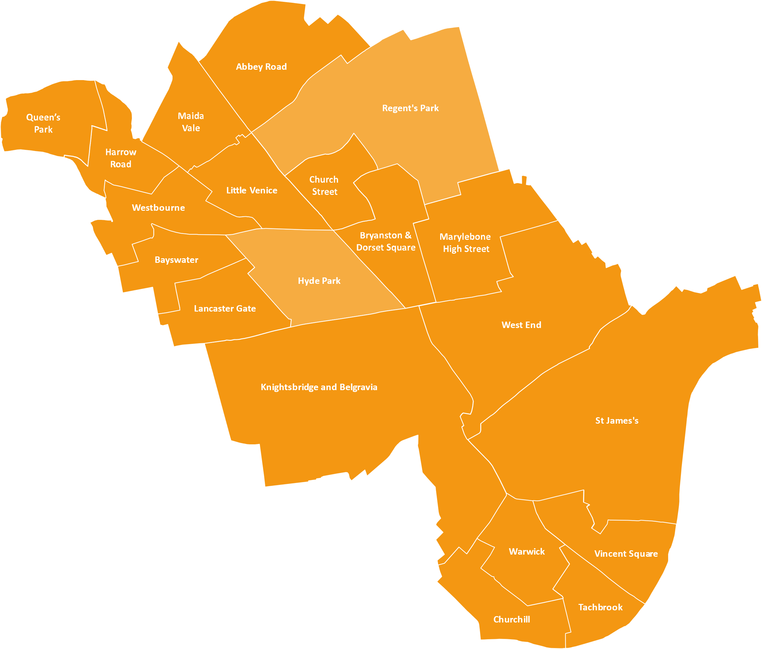


John Aird Court Y107
5
years
Years

Slide 5
Y107 John Aird Court

Slide 6
John Aird Court Y107
Scope of Works Include
Pre-condition surveys
Scaffolding
Internal surveys
Window renewal
Roof renewal to 10 no. blocks (1-6, 7-17, 18-40, 41-55, 56-70, 71-93, 94-106, 107-115, 127-149 & 150-165)
PV panel installation and associated electrical works to all blocks
Fire Risk Assessment works
Installation of new fire rated FEDs to tenanted properties with leaseholder opt-in
Communal internal and external decorations
Brick and concrete repairs
Relocation & replacement of extractor fans currently through windows and associated electrical works
Landscaping works

Slide 7
John Aid Court Y107
Surveys and Procurement
Attended site and carried out a measured survey to all blocks.
We produced elevation drawings & submitted planning application for all works that are involved.
Scope surveys were also conducted to identify provisional areas of repairs to the external areas, based on the ground floor surveys we carried out.
A further survey is required to confirm actual measures once the scaffolding is in place.
Following on from the surveys each package of works has been issued for pricing to our supply chain for competitive market prices.
The planning application will now have a non-material amendment submitted to allow for the window design change.
Total budget for the works element only not including WCC management costs is £8,844,429.98
Window Ballot/Decision
The Window Working Group (WWG) had a pivotal role in providing ideas for different window designs over the last year or so.
The WWG, along with WCC, Axis and a window designer decided on two options for ballot.
All residents were invited to take part in the ballot which concluded on 7th August 2024 and the decision for UPVC and the Alternative Design was chosen.
Following the ballot, Axis need to submit the non-material amendment for the planning application. Original application was Upvc and like for like design.

Slide 8
John Aird Court Y107
Blocks and timetable
1-6
107-115
Block | Anticipated Start Date | Anticipated Finish Date
1-6 (LRB) | 13/01/2025 | 17/04/2025
7-17 (LRB) | 03/02/2025 | 29/05/2025
94-106 (LRB) | 24/02/2025 | 03/07/2025
107-115 (LRB) | 24/03/2025 | 26/06/2025
216-228 (LRB) | 14/04/2025 | 24/07/2025
166-176 (LRB) | 12/05/2025 | 31/07/2025
116-126 (LRB) | 02/06/2025 | 21/08/2025
127-149 (HRB) | 23/06/2025 | 11/11/2025
150-165 (HRB) | 24/07/2025 | 28/11/2025
177-192 (HRB) | 26/08/2025 | 10/12/2025
193-215 (HRB) | 26/08/2025 | 19/01/2026
18-40 (HRB) | 29/10/2025 | 19/03/2026
41-55 (HRB) | 01/12/2025 | 14/04/2026
56-70 (HRB) | 01/01/2026 | 15/05/2026
71-93 (HRB) | 03/02/2026 | 10/06/2026
Non-block works | 27/06/2025 | 10/07/2026
7-17
94-106
18-40
41-55
56-70
71-93
116-126
216-228
127-149
150-165
177-192
193-215
166-176

Slide 9
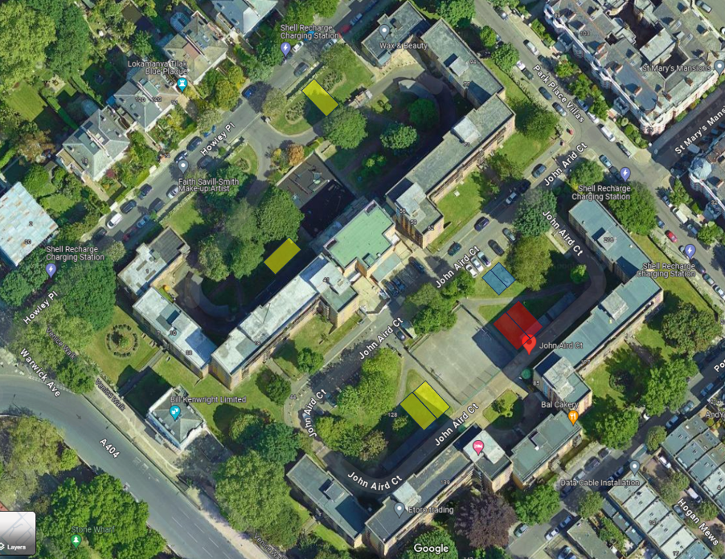
John Aird Court Y107
Proposed site set up
Resident Drop-In Location
Site Storage
Axis Welfare Compound

Slide 10


John Aird Court Y107
Window Survey
Our RLO will make an appointment with the residents and leaseholders. Our surveyor will carry out a survey and compile a report with measurements to proceed to manufacture. As a part of the survey, this will include identifying any making good and/or decoration works that is required for the new windows and doors to be installed. During this visit, Axis will also conduct a pre-condition survey to ascertain the current condition of the property. Time for the survey will be up to 1 hour. Once the windows have been manufactured (est. 8-10 weeks), we will inform residents of an installation date. A minimum of two weeks’ notice will be given. During this visit, the pre-condition survey will be checked and amended if any change has occurred in a residents property.

Slide 11


A RESIDENT
FOCUSED SERVICE
OUR RESIDENTS MATTER

Slide 12



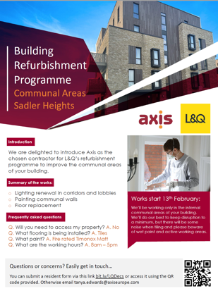
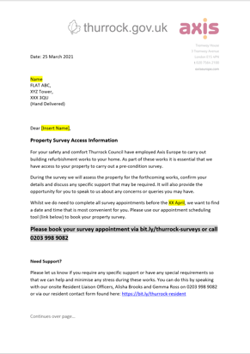

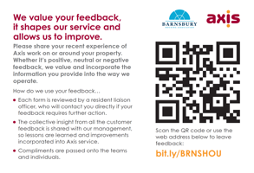
CLEAR COMMUNICATION
We aim to build a close relationship with residents and keep you informed of progress throughout the project. A Resident Liaison Officer will be available throughout the project during working hours in our Resident Drop-In Location.
We have a number of communication tools…
…so you are comfortable with the work taking place around your property
OUR RESIDENTS MATTER

Slide 13


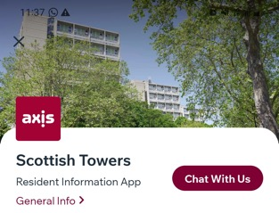


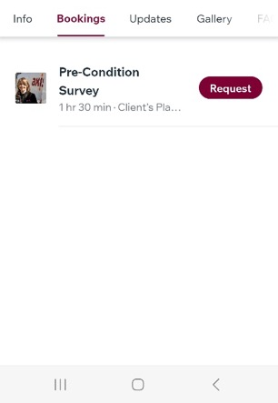
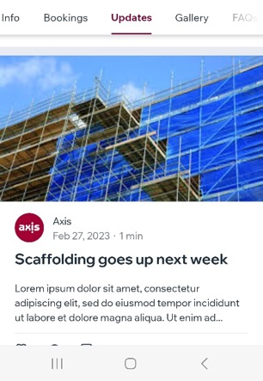
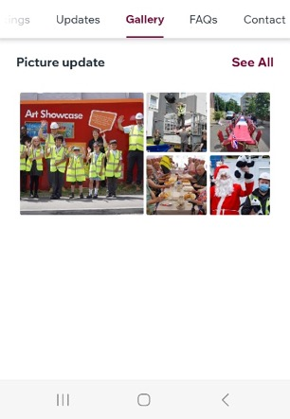
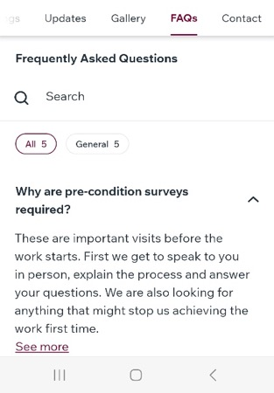





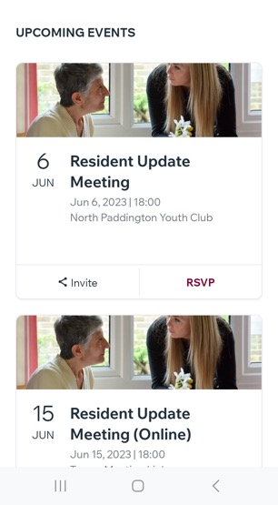
RESIDENT APP
Let’s stay connected…
Receive latest announcements
Find out about resident events
Book appointments
Keep up to date with the project’s progress
See photos of what the team are up to
Find answers to frequently asked questions
Contact the team
Schedule of monthly coffee mornings
…inc live chat (during working hours)
13

Slide 14

Thank You
Any Questions ?
Hallfield Presentation
26.06.2023
Marc Jeffrey

