Slide 1

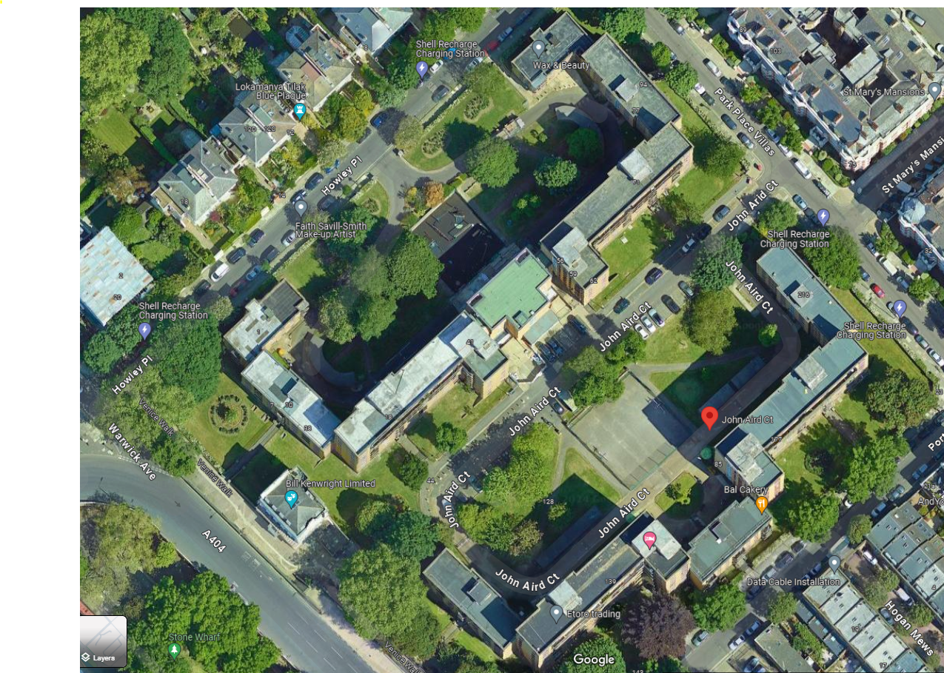
WCC, Y107 John Aird Court – Proposed Site Welfare Location
Resident Drop In Location (resident meetings/ coffee mornings)
Four 20x8ft (approx. 6mx2.5m) Storage Containers
Welfare: Four 20x8ft (approx. 6mx2.5m) units including; Meeting Room, Drying Room Canteen and Site Office (Two double stacked units)
Welfare: Two W/C Units
(Three single cubicles in each)

