Slide 1
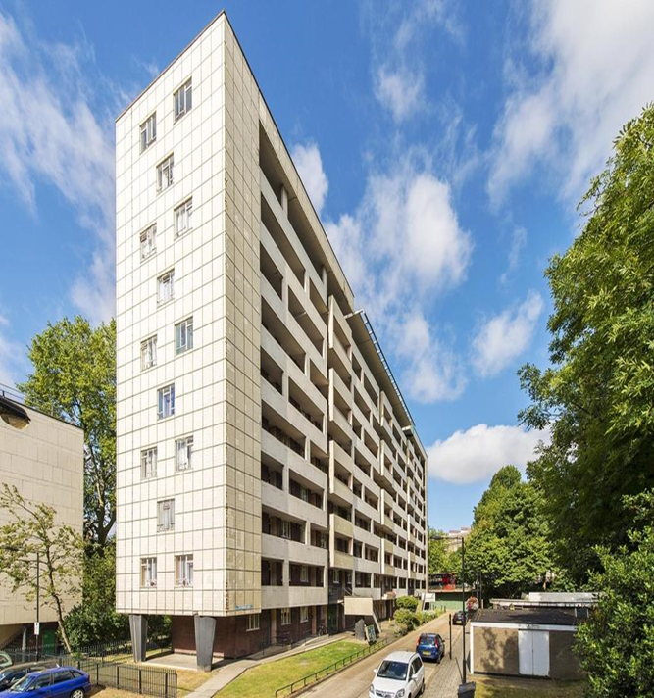
Hallfield – Major works Phase 3
SPP Presentation
26th June 2023
Hallfield Presentation
26.06.2023
Marc Jeffrey

Slide 2
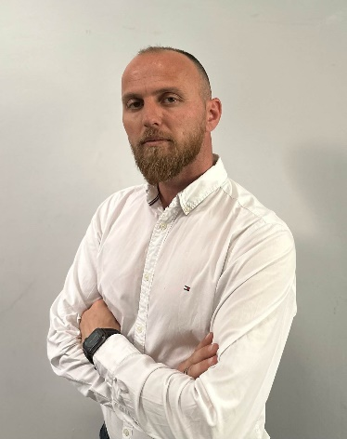
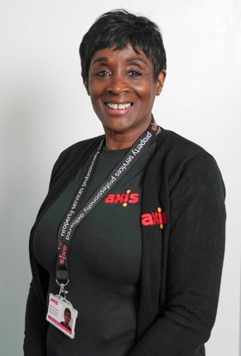
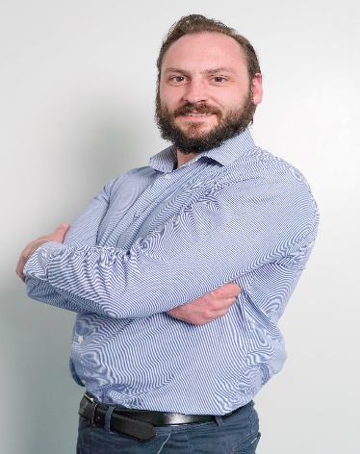
Hallfiled X115
Marc Jeffrey
Project Director
Craig Roberts Divisonal Manager
Eric Sejat Contracts Manager
Patricia Charles Senior RLO
Dan Sams Pre-construction Manager

Slide 3
About Axis
Established
Ownership
Turnover
Staff
1986
Family
£245m
1,000+
Offices
Credit Rating
Values Led
Fleet
7
5A 2
8 Values
450+
Big enough to deliver. Small enough to care

Slide 4
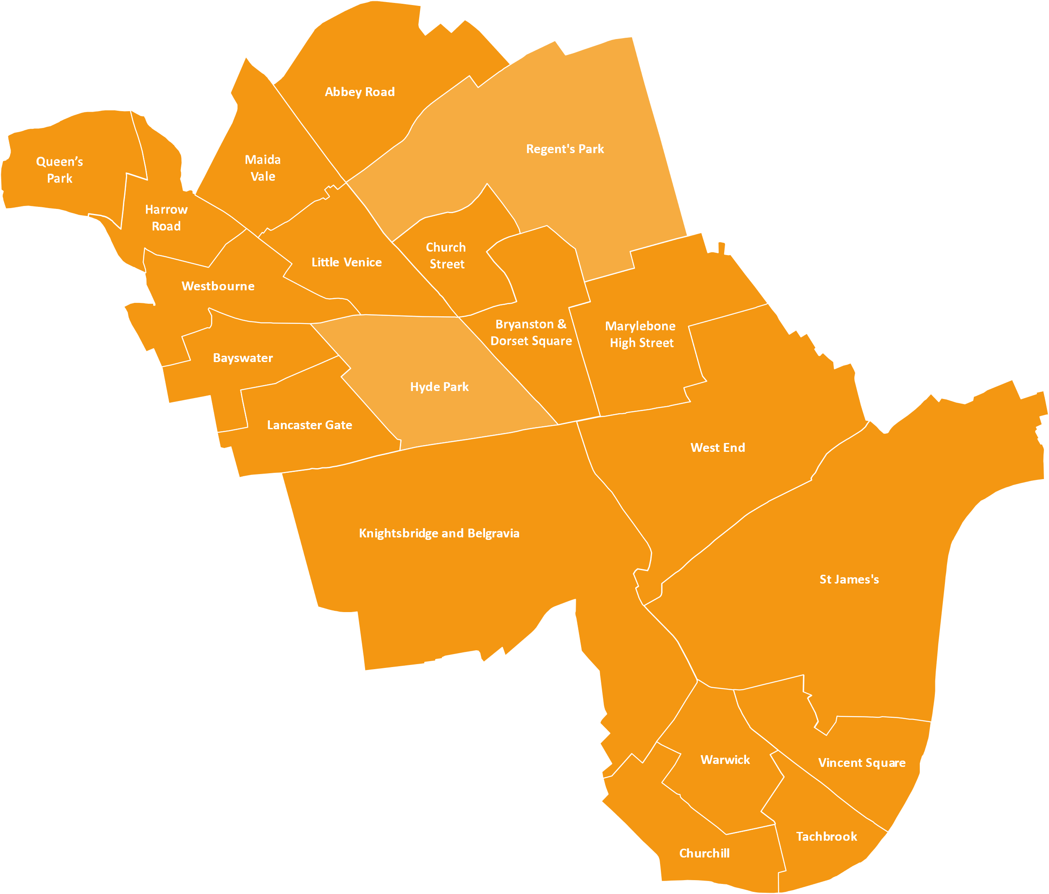
Hallfiled X115
5
years
Years

Slide 5
Hallfield Presentation
26.06.2023
Marc Jeffrey
Hallfield Estate

Slide 6
Hallfiled X115
Scope of Works Includes
Pre-condition surveys
Scaffolding
Internal surveys
External repairs and refurbishment
Window replacements
Communal door replacements (intake rooms) and front entrance doors (tenant flats with leaseholder opt-in)
Installation of extract fans to kitchen and bathrooms of tenanted properties (leaseholder opt-in)
Internal builders work in connection (BWIC) with door, window and fan installs
Fire risk assessment works
External communal lighting
External decorations

Slide 7
Hallfiled X115
Surveys and procurement
Attended site and carried out a measured survey to the three blocks.
We produced elevation drawings & submitted planning for all works that are involved.
Scope surveys were also conducted to identify provisional areas of repairs to the external.
These are based on the ground floor surveys we carried out.
A further survey is required to confirm actual measures once the scaffolding in place.
Lesson learnt from previous phases – Windows set in tiled elevations are susceptible to water ingress issues. A solution has been agreed and implemented at Marlow House.
We will need to replace tiles to heads and sides of the windows in tiles elevations at Winchester House
Following from the surveys each package of works were issued for pricing to our supply chain for competitive market prices.
Total budget for the works is £5,612,749 Million which is within 8% of the initial budget set by WCC last year.

Slide 8
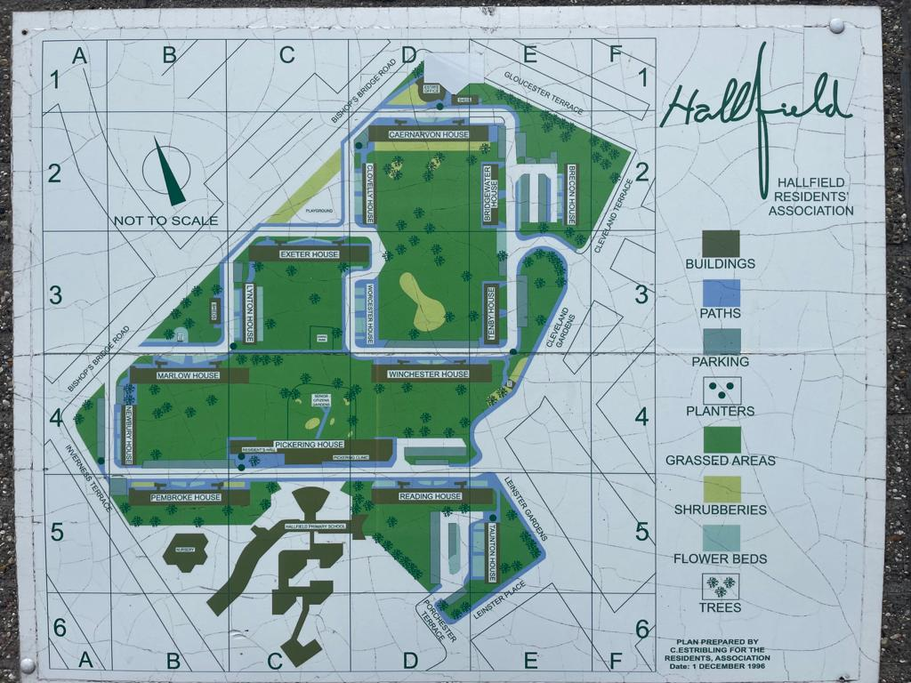
Hallfield X115
Blocks and timetable
Worcester House
Start Date 07/03/24
Completion Date 7/10/24
Duration weeks 31
Lynton House
Start Date 24/07/24
Completion Date 03/03/25
Duration weeks 33
Winchester House
Start Date 21/08/2023
Completion Date 06/06/24
Duration weeks 43

Slide 9
Hallfield X115
Proposed site set up
Axis Welfare Compound
Residents Surgery
Winchester House

Slide 10
Hallfield X115
Window survey
Our RLO will make an appointment with the residents and leaseholders. Our surveyor will carry out a survey and compile a report with measurements to proceed to manufacture . As a part of the survey this will include identifying any making good and decoration works that is required from the new windows to be installed Time for the survey will be 30 minutes to 1 hour Once the windows have been manufactured (est. 6-8 weeks) we will inform residents of an installation date. A minimum of two weeks notice will be given.

Slide 11
A RESIDENT FOCUSED SERVICE
OUR RESIDENTS MATTER

Slide 12
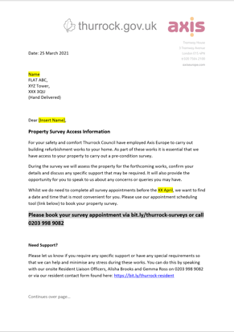
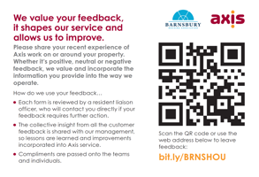
CLEAR COMMUNICATION
We aim to build a close relationship with residents and keep you informed of progress throughout the project.
We have a number of communication tools…
…so you are comfortable with the work taking place around your property
OUR RESIDENTS MATTER

Slide 13
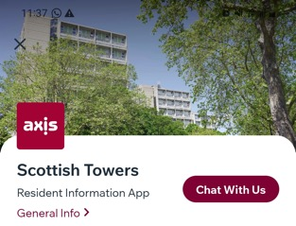
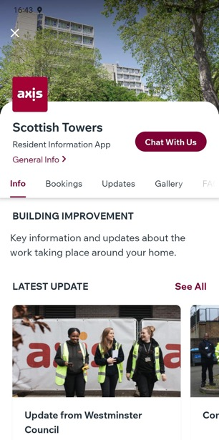
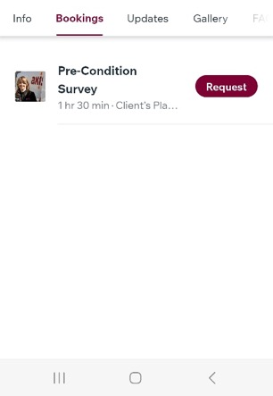
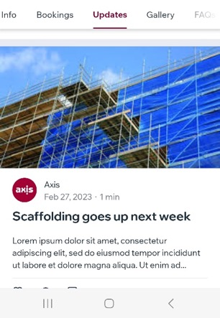
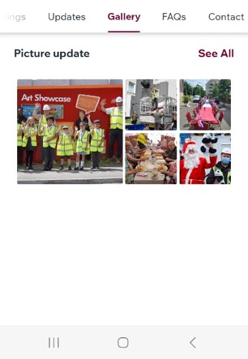
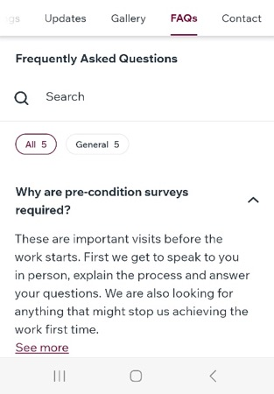
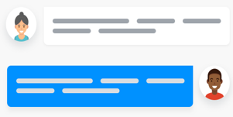
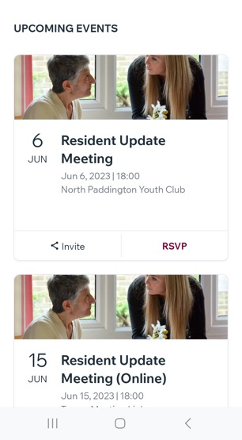
RESIDENT APP
Let’s stay connected…
Receive latest announcements
Find out about resident events
Book appointments
Keep up to date with the project’s progress
See photos of what the team are up to
Find answers to frequently asked questions
Contact the team
…inc live chat (during working hours)
13

Slide 14
Hallfield X115
Next steps
Further resident meeting being held online next Monday 3rd July. Full notes and Q&A to be sent out after this meeting. Following this meeting our leasehold team will prepare and issue the Section 20 notice of estimate costs to leaseholders The Section 20 consultation period will run for 37 days. Once all observations have been considered and responded to, we will aim for Axis to mobilise and start work on site towards the end of August. A further meeting will be arranged for residents to meet the team carrying out the work before it starts.

Slide 15
Hallfield X115
Leaseholder information
The section 20 estimate is still only an estimate, leaseholders will not receive an actual bill and need to start paying until the next service charge bill is issued in March 2024. We offer a range of payment plans for major works bills as per the table to the right. Full details are available on our website: www.Westminster.gov.uk/housing/service-charges/major-works-service-charges-payment-plans
Works cost: | Payment term
Up to £2,000 | 12 months
£2,000 and above | 24 months
£2,000 and above (Resident Leaseholders only) | 60 months
£20,000 and above (Resident Leaseholders only) | 120 months
£20,000 and above | 300 months * * This is a Discretionary Service Charge loan, available to leaseholders who are unable to secure borrowing from their mortgage company or a personal loan.

Slide 16
Hallfield X115
Leaseholder opt-ins
Leaseholders will have the option to opt-in to have a new front door fitted as part of these works. An opt-in for one or both of the extractor fans is also available: The exact cost to opt-in however can only be confirmed at survey stage. When the window surveys are carried out in each property, Axis will also survey for the door and extract fans so that leaseholders can be given an exact price to consider for opt in. WCC will write to leaseholders confirming the price and process for opting-in.

Slide 17
Thank You
Any Questions ?
Hallfield Presentation
26.06.2023
Marc Jeffrey

