Slide 1
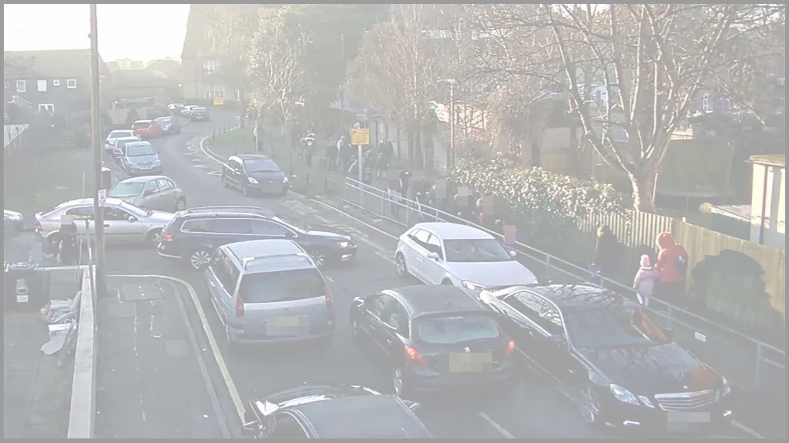


Air Quality around our school
Schools Healthy Commutes Project
Session 3
Enter primary school name - class

Slide 2


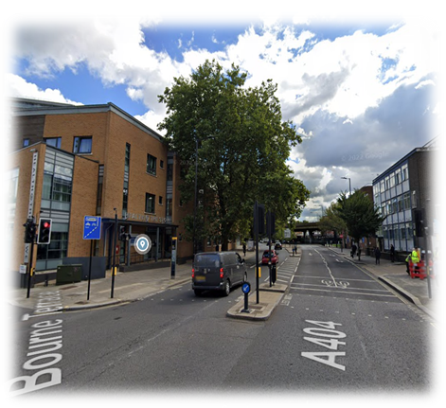
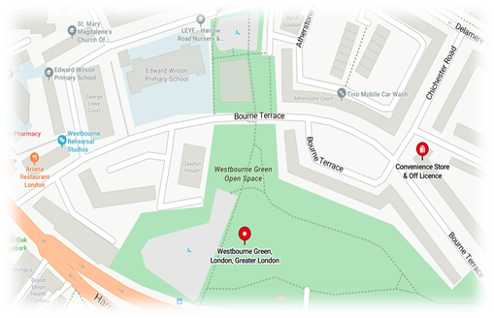
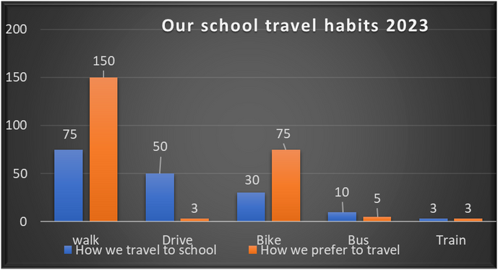
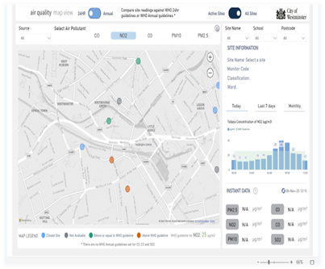

Last Time...
Thought about our own journeys to school
Surveyed our busy roads
Analysed our school travel habits
Looked at air quality in the area

Slide 3

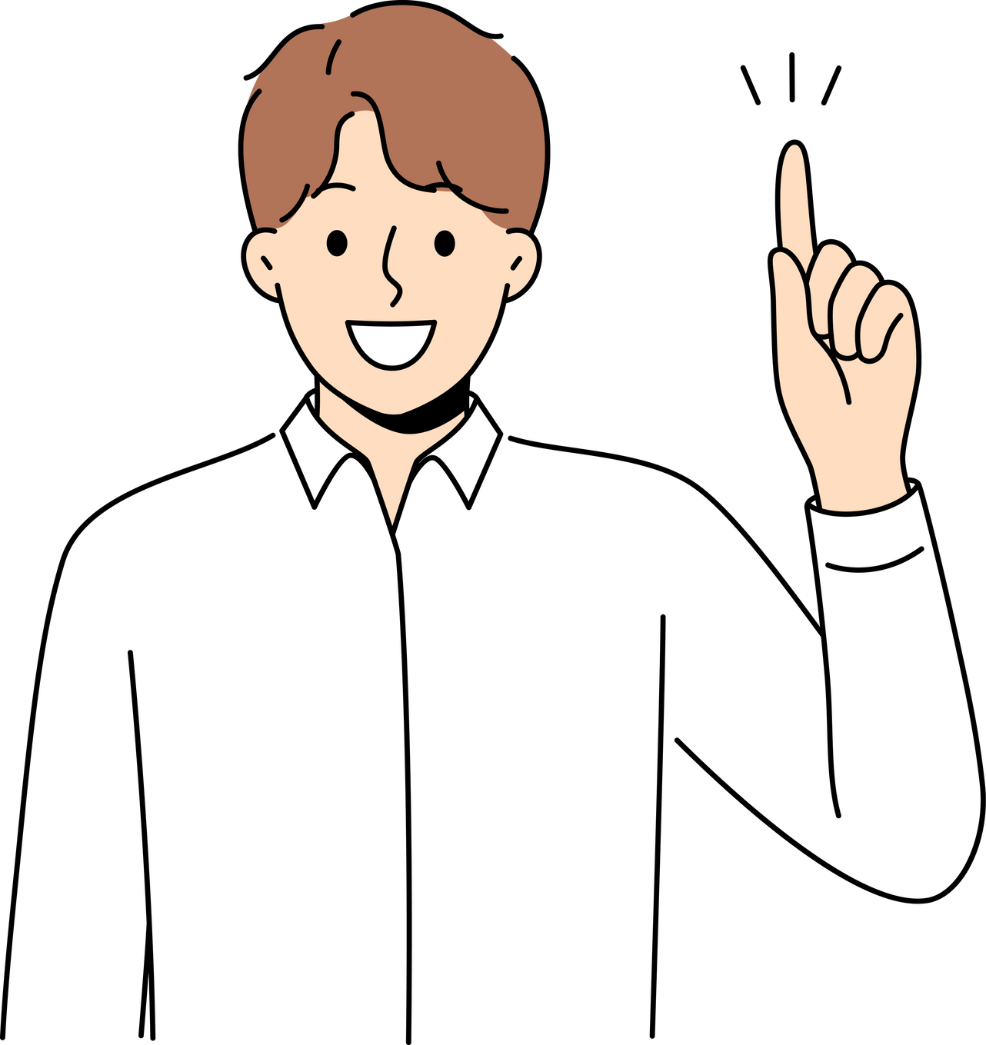
Action Planning
What action could we take to improve school travel?
How can we keep improving?
How can more children enjoy fun ways to travel?
Let’s help more children get out of cars
We want to do more cycling
What good things should we keep on doing?
How can we let everyone know?

Slide 4

What have we found out?
Our reports can help others understand the problem

Slide 5
What is the Air Quality today?
How has looking at the air quality monitor helped us understand the issues around our school?
AQ Check Today

Slide 6
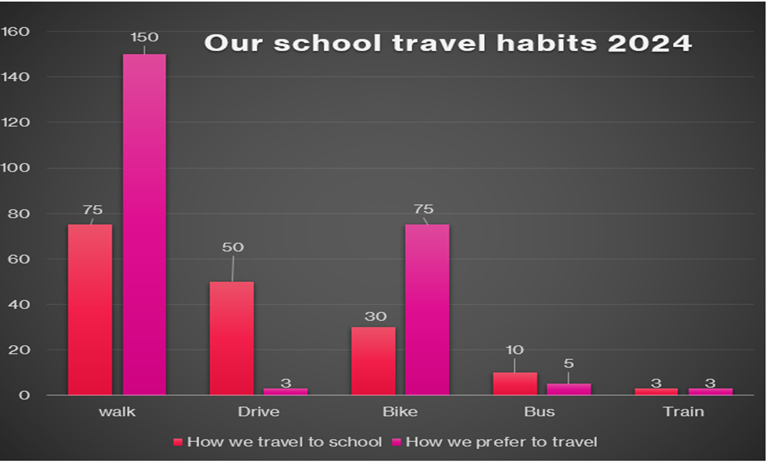
Our school travel habits 2024
  What are we good at?
  What do we want to do?

Slide 7



Campaign Ideas
Group 1: Get more children on bikes and scooters!
Prompts:
  More children want to cycle/ scoot - what/ who is stopping them?
  What fun ideas could create a big buzz at school?
  Who would you need to persuade? Parents? Children? The school?
  How would you spread your message? Posters? Badges? Webpage? Performance? Video?

Slide 8


Campaign Ideas
Group 2: Get more children out of cars!
Prompts:
  What facts and data have we learnt that could help change people’s minds about driving? (Safety, health...)
  What practical ideas could help parents start ditching the car?
  Who would you need to persuade? Parents? Children? The school?
  How could you spread your message? Posters? Newsletter? Assembly?

Slide 9
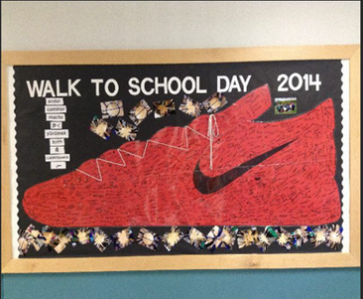

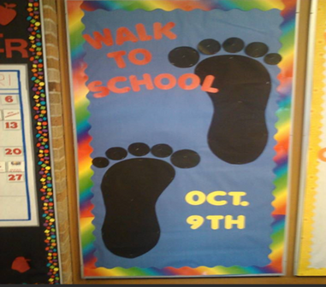
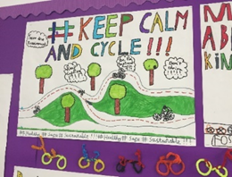
Campaign Examples
Put on a school assembly
  Tell everyone about the benefits of active travel (and problems with too many cars!)
  Share your knowledge from your investigations and data analysis
Make an active travel display board
  Include some 3D models
  Contact Bike-It or Walk to School for some leaflets and information

Slide 10

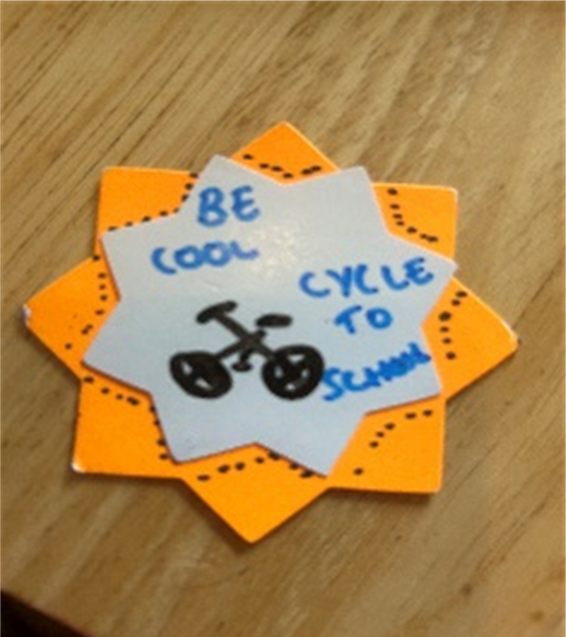
Campaign Examples
“Be cool, scoot/ cycle to school”
“Ditch the car”
Make a badge or poster promoting cycling/ walking to school
  Use an eye catching picture
  Think of a snappy slogan (discuss ideas with a friend)
  Use bold colours
  Add patterns and a small picture to support your message. Safety pin can be taped to the back of the card
“Walk or run, it’s more fun!”

