Slide 1
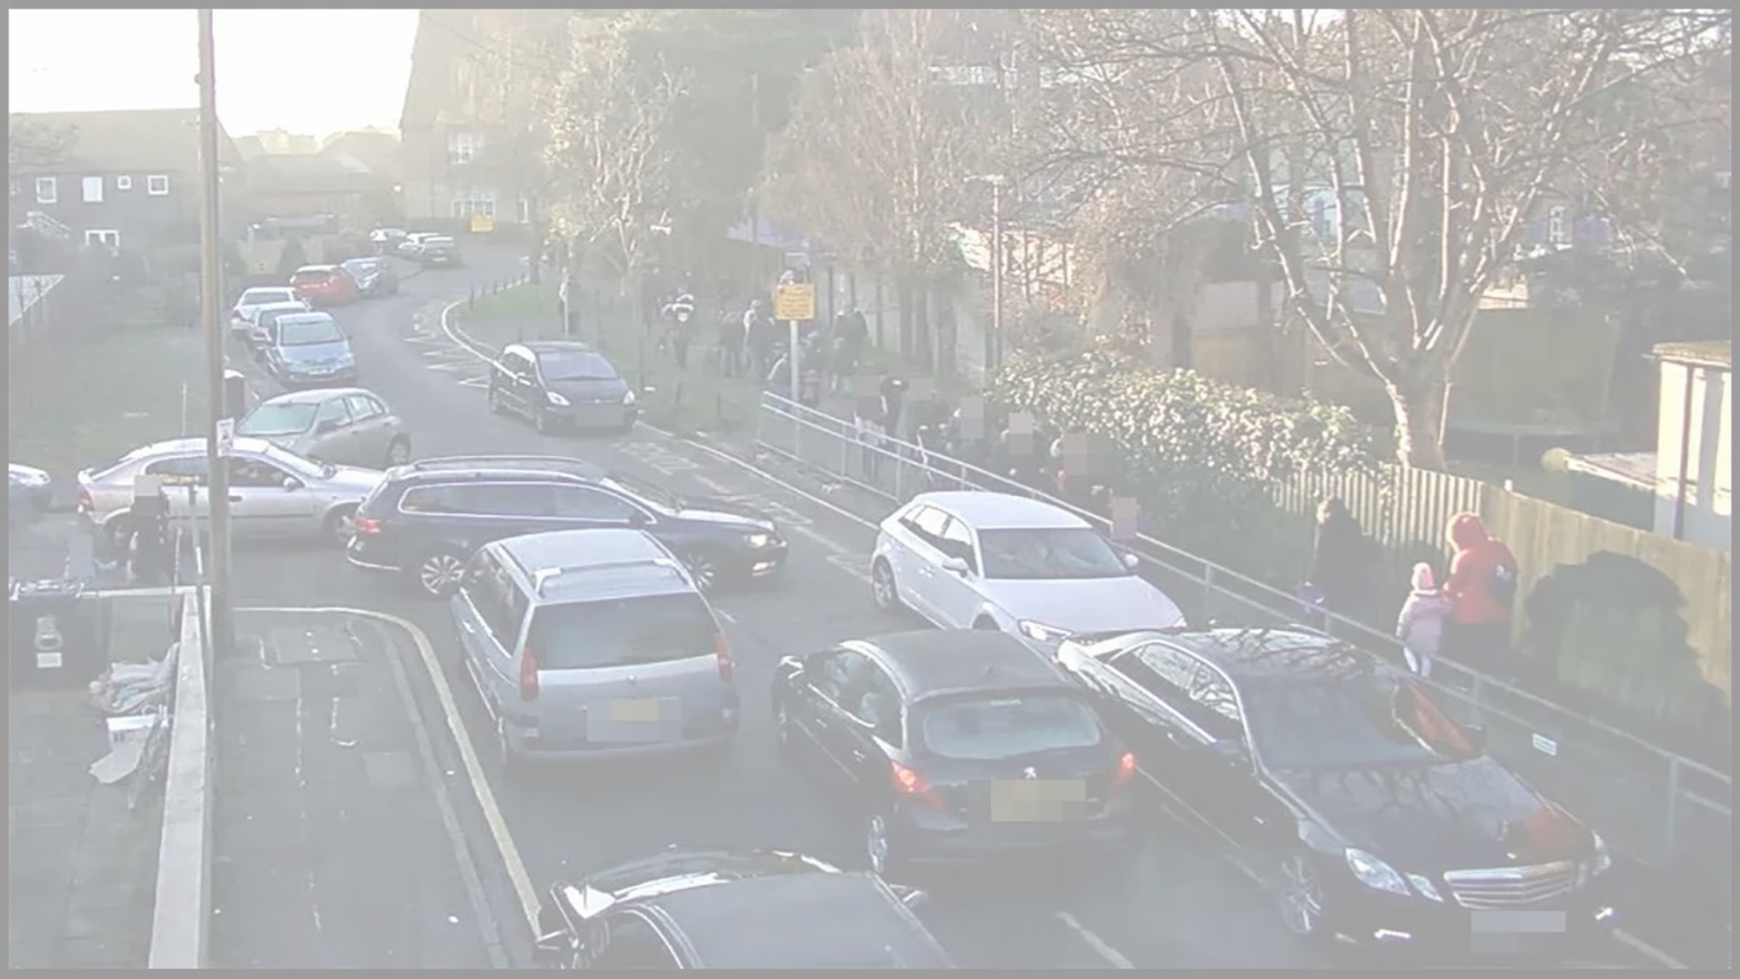


Air Quality around our school
Schools Healthy Commutes Project
Session 2
Enter primary school name - class

Slide 2
Our school’s travel habits
Does our school contribute to pollution and poor air quality by how we travel every day?

Slide 3
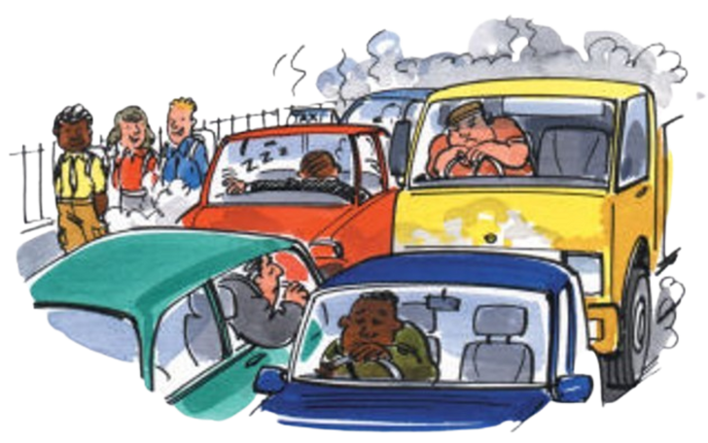


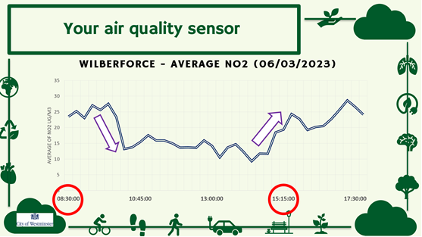


Last Time...
Counted traffic in our local area - how bad is it?
How poor air quality affects our health
Looked at the data on air quality collected by Westminster City Council
We looked at the affects of pollution on air quality

Slide 4
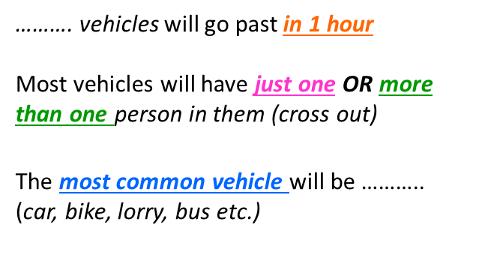
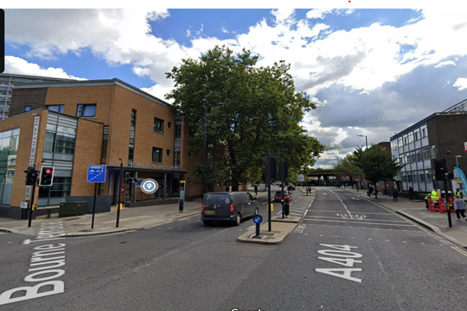
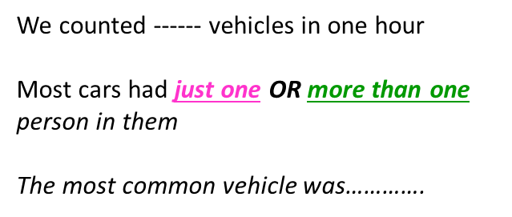
Recap
Name:
Date:
Traffic Survey Location:
How much traffic is in our local area?
I predict that:
Traffic Survey on:
My Findings:
In one hour, we counted approx ____ vehicles

Slide 5








Recap
Name:
Date:
Look carefully at the scores for each stop. Put a circle around scores below 3
0 = Very Bad 5 = Very Good | Stop 1 | Stop 2 | Stop 3
Riding Bike or Scooter Bike lanes, scooter shed Bumpy road, nowhere to park, scooter/bike
Easy to cross the road Deisgnated road crossing It is hard to cross the road safely
Street lighting and access Designated road crossing It is hard to cross the road safely
Open space Buildings very close Large open spaces
Access to public transport Bus stop or tube, short walk to school Bus stop or tube over 10 minute walk away
Plants No Greenery Plenty of trees, plants and grass
Air Pollution Smelly fumes, car exhausts Fresh clean air, pleasant to breathe
Noise Pollution Very loud noise Quiet, relaxing sounds
People feel safe Low risk of crime injury Feels scary, anti-social, not safe
Make a list of what made it a low score for each stop. E.g Stop 1 there is nowhere close by to cross the road safely
Why do you think stop ________ had the highest score?
What did we like most about it?
Stop 3 was outside our school. What improvements could be made to help us travel more sustainably?
What does each stop tell us about how easy it is to get to school by foot, bike or public transport?

Slide 6

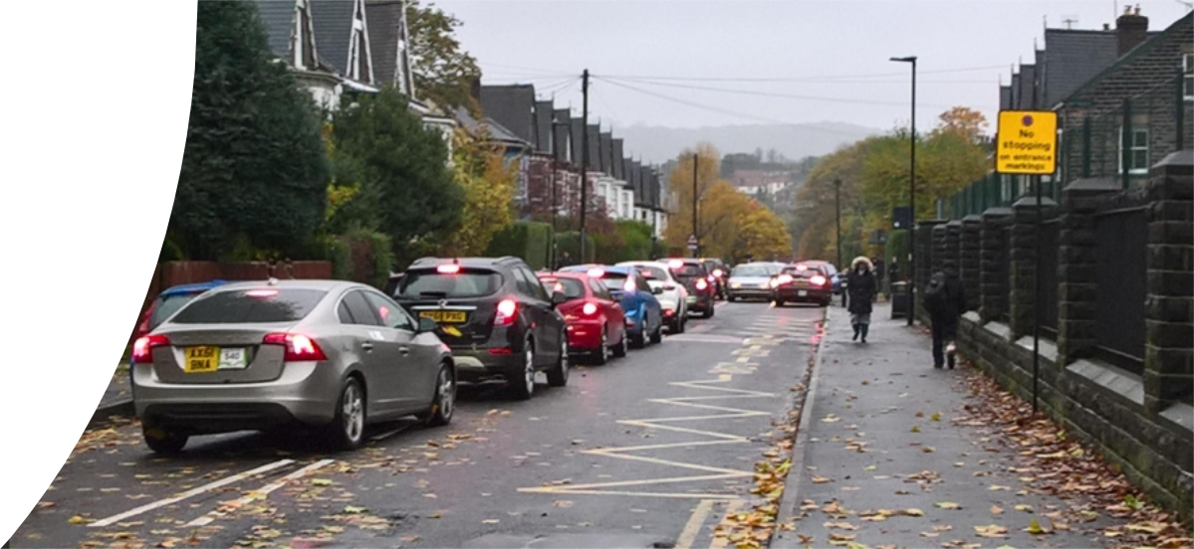
What did we find out?
  What do the traffic survey findings tell us about possible pollution in the local area?
  What area of our school has the most pollution?
  What do you think that tells us about school roads?

Slide 7
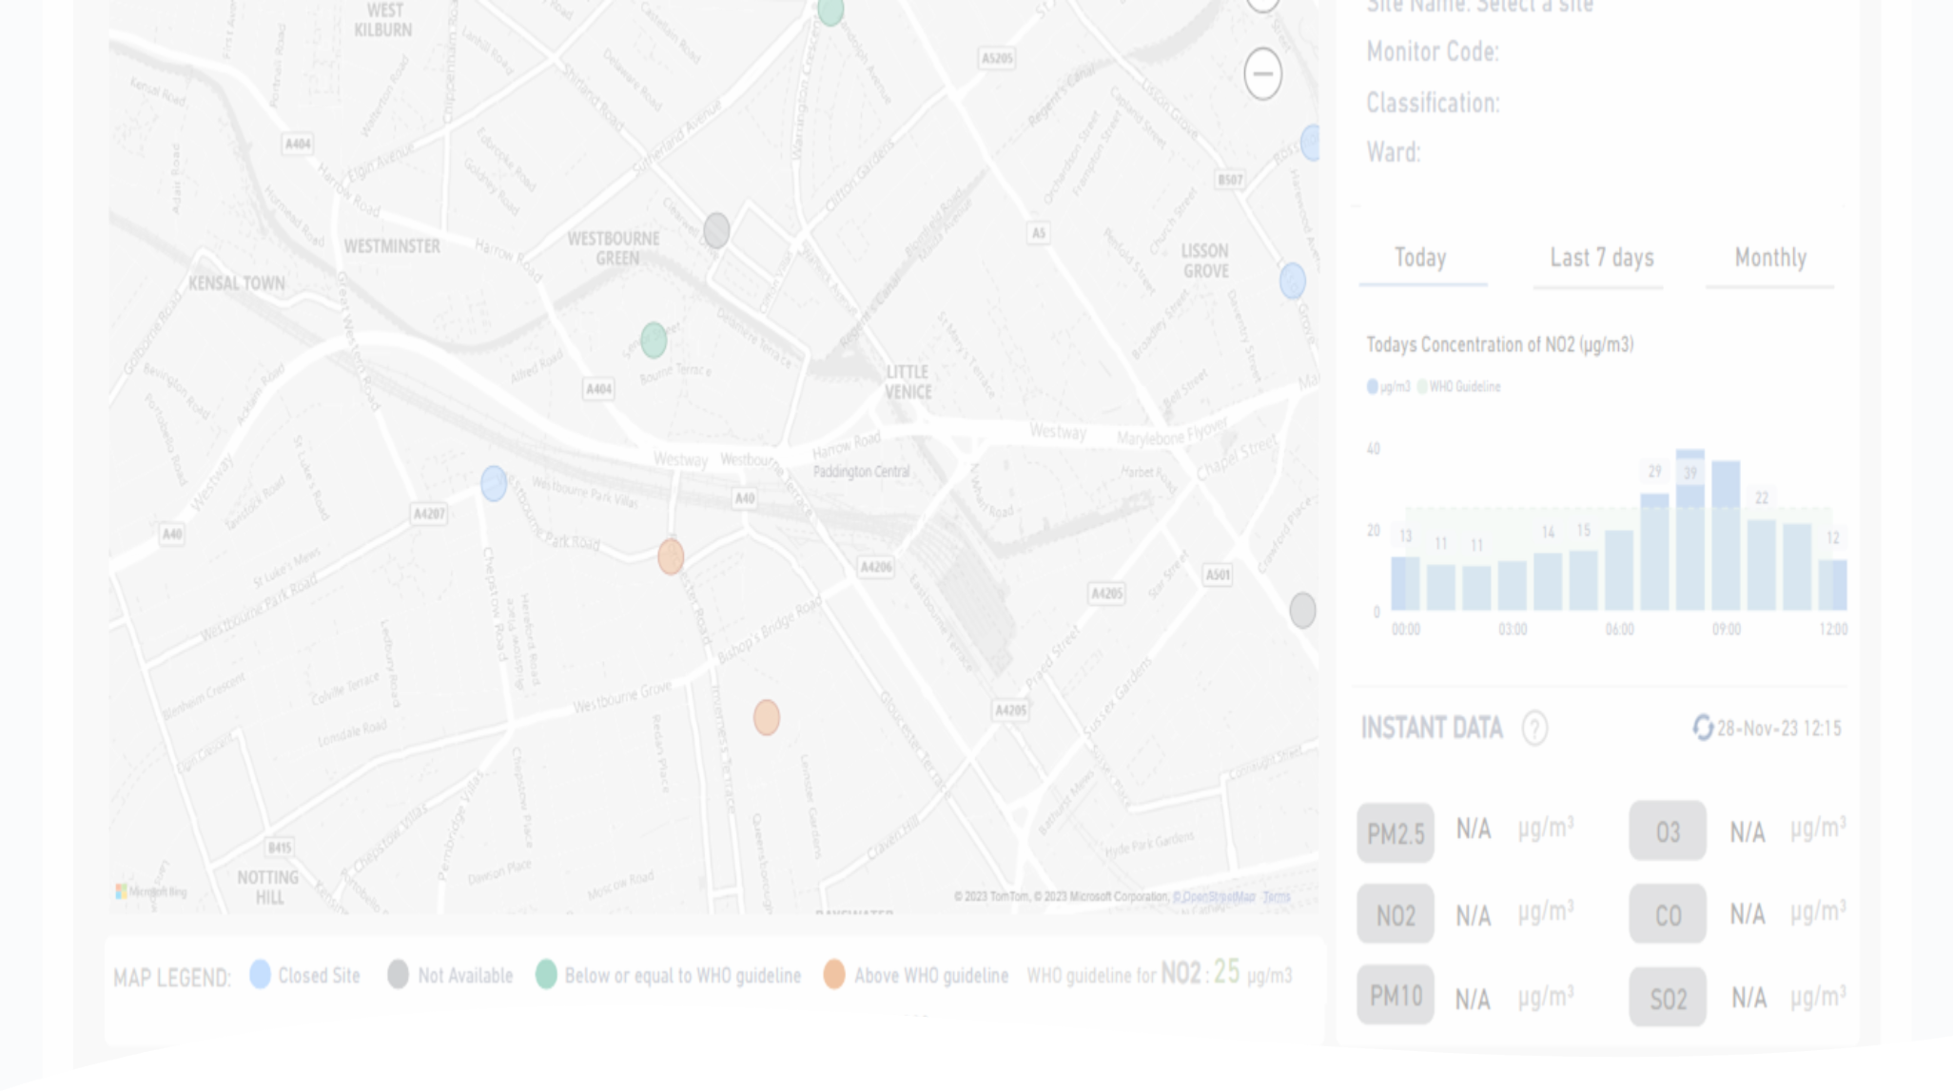
Today’s air quality
  Using our school AQ sensor to check pollution and air quality today
  What can we find about today’s traffic and pollution?
  Is it better or worse than last time?

Slide 8








Comparing the data to last time
Do the spikes look the same as last time?
Will it look different throughout the day? Look at your school between 8am - 9am, and then 1pm - 2pm
What is affecting the results for various locations
What patterns are we beginning to see?

Slide 9
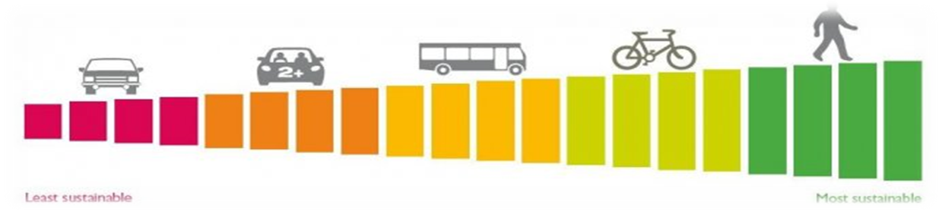

Our school’s travel habits
Does our school contribute to pollution by how we travel every day?
Using our hands up survey, we will create Excel graphs to compare and analyse our school travel habits

Slide 10
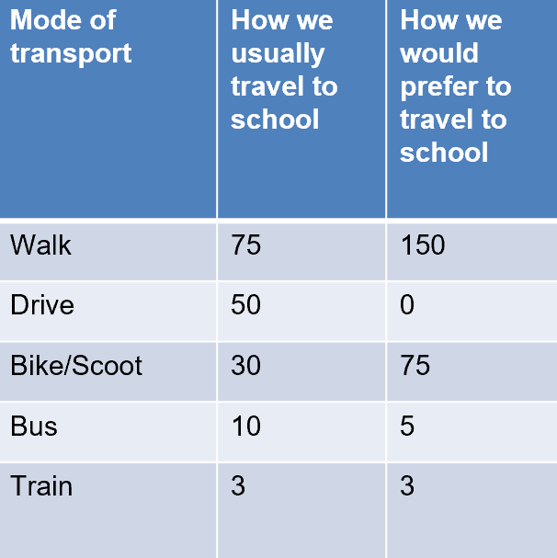
What is the most popular way of travelling to school?
Step 1
  Open excel
  Stretch out columns A, B and C to make them wide enough for the titles
  Copy this table, showing results of your school’s recent travel surveys

Slide 11
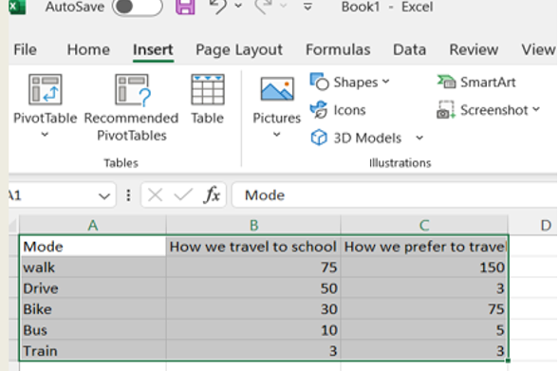
What is the most popular way of travelling to school?
Step 2
  Highlight your table: It should look like this!
  To capture the whole table with no extra rows or columns
  Hold down the left button on the mouse, and drag the curser down and across

Slide 12

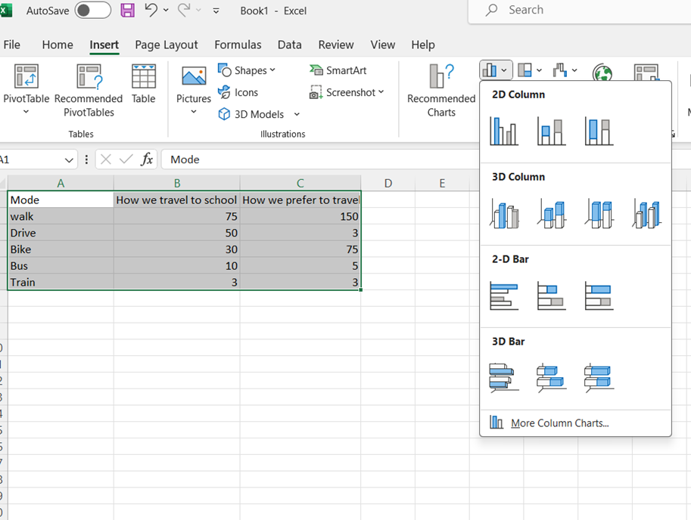


What is the most popular way of travelling to school?
2
Step 3
  Next, click on Insert from the tabs along the top of the screen and select Column from the chart types underneath
  Select the first 2D column from chart types
1
3

Slide 13
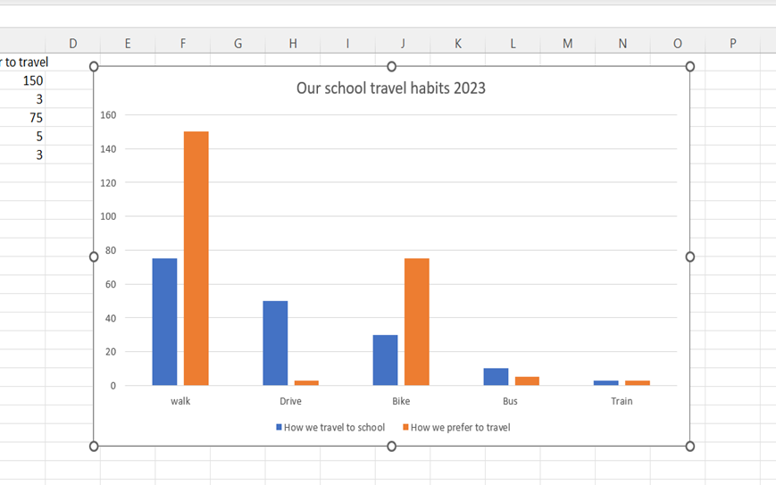

What is the most popular way of travelling to school?
Step 4
  Now give your chart a title
  Click on layout (under ‘chart tools’) from tabs along top of the screen and then select chart title
You can also try to click on the word title and change the text there

Slide 14

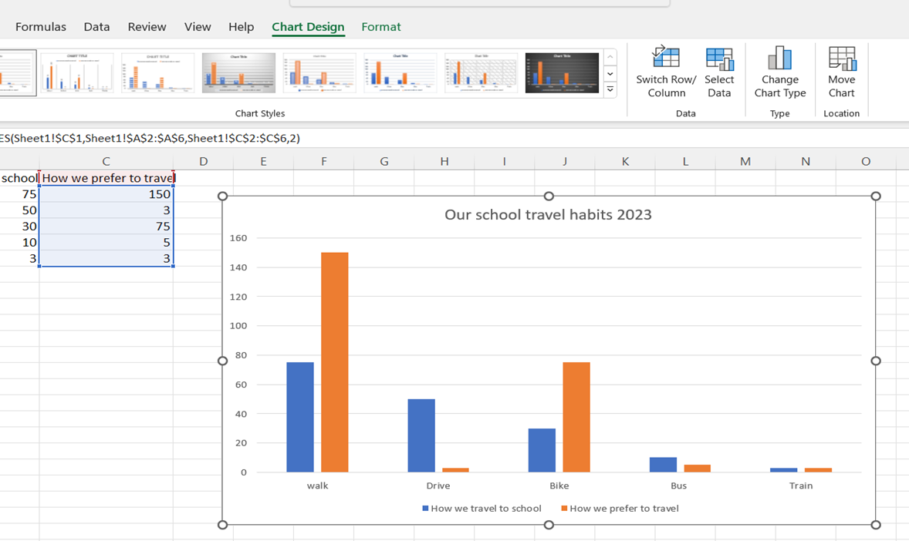
What is the most popular way of travelling to school?
Step 5
  You can click on chart design to customise your graph by using different colours. Then cut and paste it into a word document.
  Think of 3 to 4 questions what the data tells us about your school habits

Slide 15
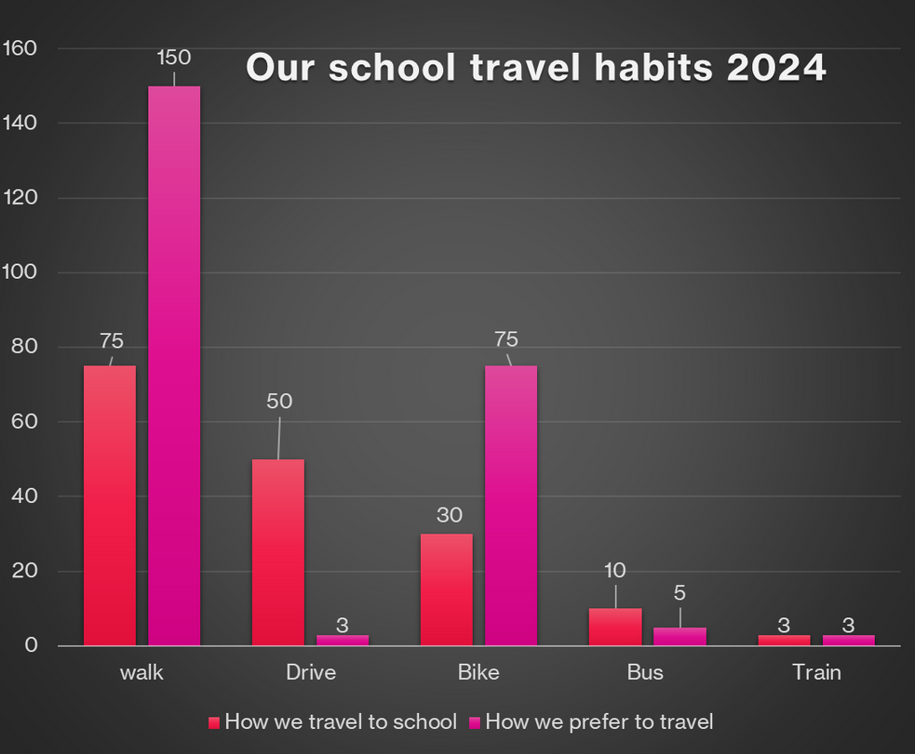
What does this tell us about our travel habits?
Here are some example questions:
  What is the most popular way we travel?
  Why do you think so many children come by car?
  Why is there less cycling and how could we encourage more children to bike to school?
Make a short report of your findings

Slide 16


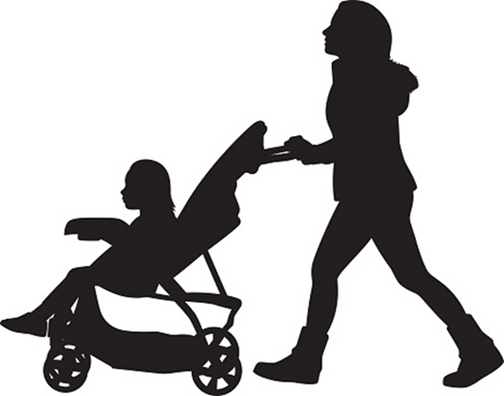
Next Time...
  Using our reports to understand our school travel habits
  Action Planning!
  What does our school do well?
  What can we improve and how?

