Slide 1

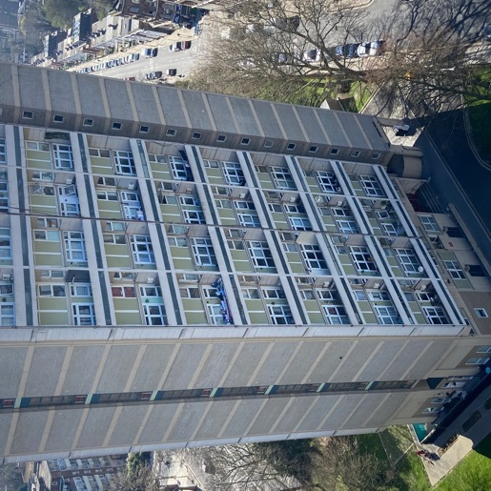

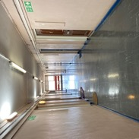
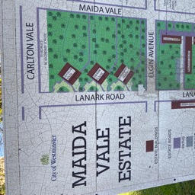

SCOTTISH TOWERS
(AB108)
INTRODUCTORY MEETING
6 JUNE 2023

Slide 2






AGENDA
Decarbonisation
01
03
Introduction
04
Resident focused service
Where
we are
02
02

Slide 3
AXIS
Established
Ownership
Turnover
Staff
1986
Family
£245m
1,000+
Offices
Credit rating
Values led
Fleet
7
5A 2
8 values
450+
03

Slide 4

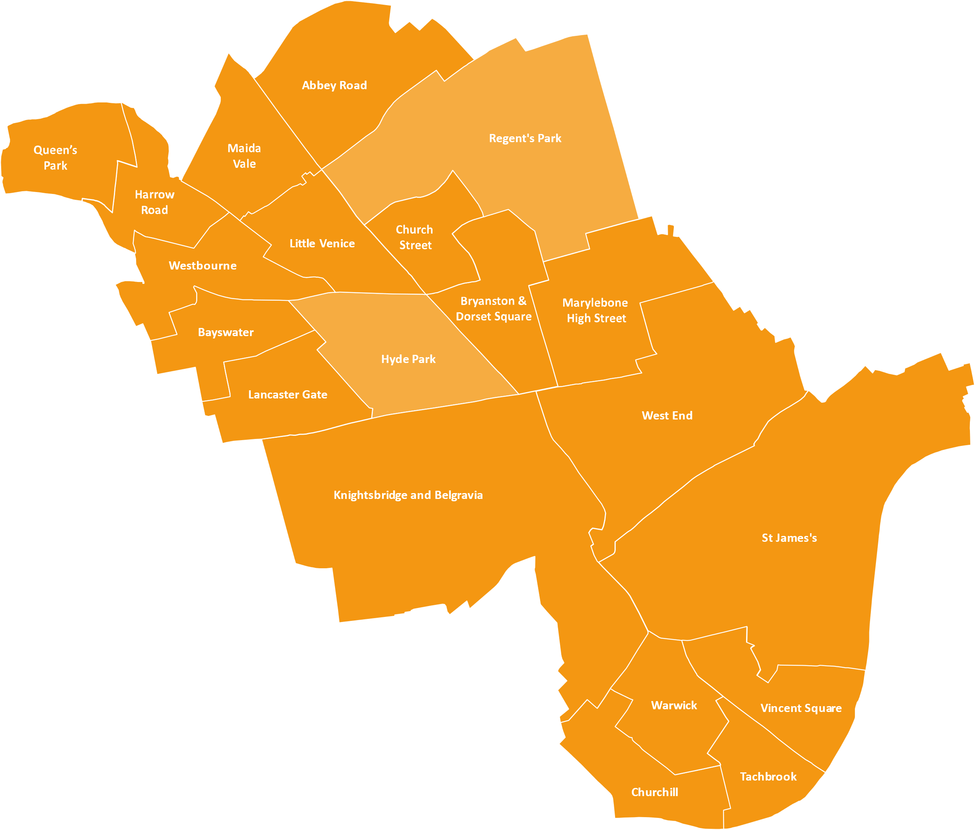




AXIS
5
years
04
Construction
partnering

Slide 5
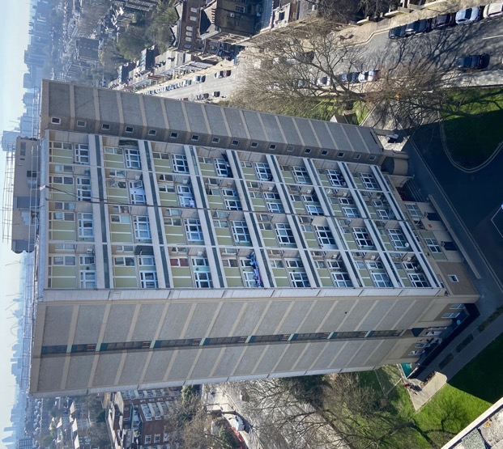




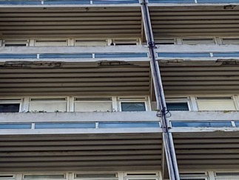
SCOTTISH TOWERS
Protection fan
around the base of the blocks
Split project to
external and internal
Set up a team of
Senior Managers
Early April
05

Slide 6
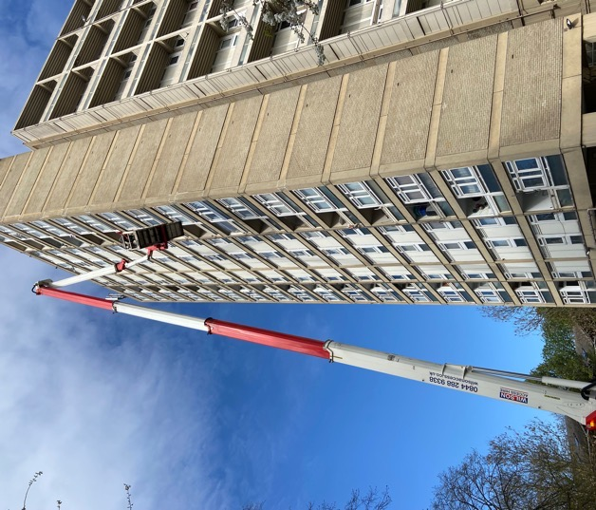
SCOTTISH TOWERS
EXTERNAL
Scaffold
Marc Jeffrey
Topographical Survey, Complete
Utilities Survey, Complete
Scaffold Designer Engaged,
Design back 9th June
Ready to tender 12th June
Masonry
Lee Convington
Structural Engineer Engaged, 4th April
Concrete Testing Complete, 9th April
Schedule of Repairs Complete, 16th April
New Building Regulations Implication's included (Grit Blasting )
Ready to tender 12th June
Windows
Lee Convington
Specification agreed 12th April, Complete
Installations issues around Gas &
Central Heating
Ready to tender 12th June
06

Slide 7
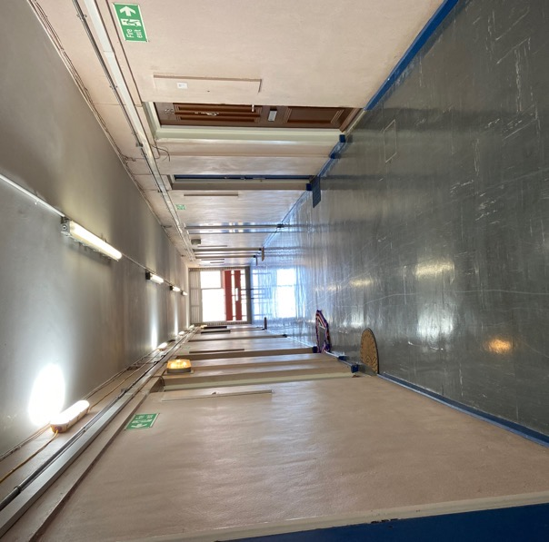
SCOTTISH TOWERS
INTERNAL
Fire doors
Marc Jeffrey
Specification agreed
Need to carry out a full intrusive survey, (To start in the next few weeks )
Decorations
Marc Jeffrey
Specification agreed
Measured
Ready to tender 12th June
Floor finishes
Marc Jeffrey
Specification agreed
Asbestos testing, awaiting
Ready to tender 12th June
Mechanical & Electrical
Dan Sams
Full Design Complete 30th May
Project Scheduled out into components and quantities
Ready to tender 12th June
07

Slide 8

CONSULTANTS
GEORGE
CHARALAMBOUS
T&T Consultants
DUNCAN MCAPLINE Furness Partnership Consulting Engineers
JAMES MELLING Mellingbuild
08

Slide 9



SCOTTISH TOWERS
DECARBONISATION
MAIDA VALE

Slide 10
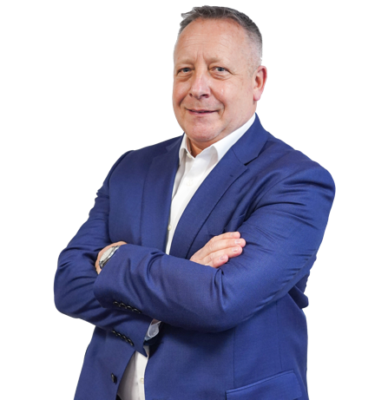
EXPERIENCED & INNOVATIVE
MANAGEMENT AND TEAM
Team lead for Axis’ M&E Division with over 35 years experience, including:
H&V News - Industry Awards Judge for Innovation and Technologies
Carbon Energy Saving Technology
Design and Build Domestic, Commercial and District Heating Systems, Hybrid Communal Systems, Retrofit designs.
Gas Compliance Programmes
Electric Compliance Programme
Water Hygiene Works
Responsive Contracts Management in all M&E Discplines
Alan Noble
M&E Director

Slide 11

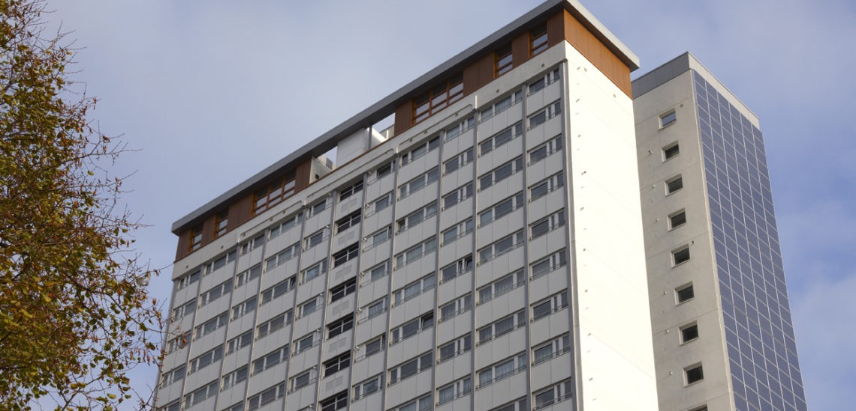
SCOTTISH TOWERS (AB108) INTRODUCTORY MEETING
SOLAR WALL
REDUCING ENERGY TO COMMUNAL AREAS

Slide 12
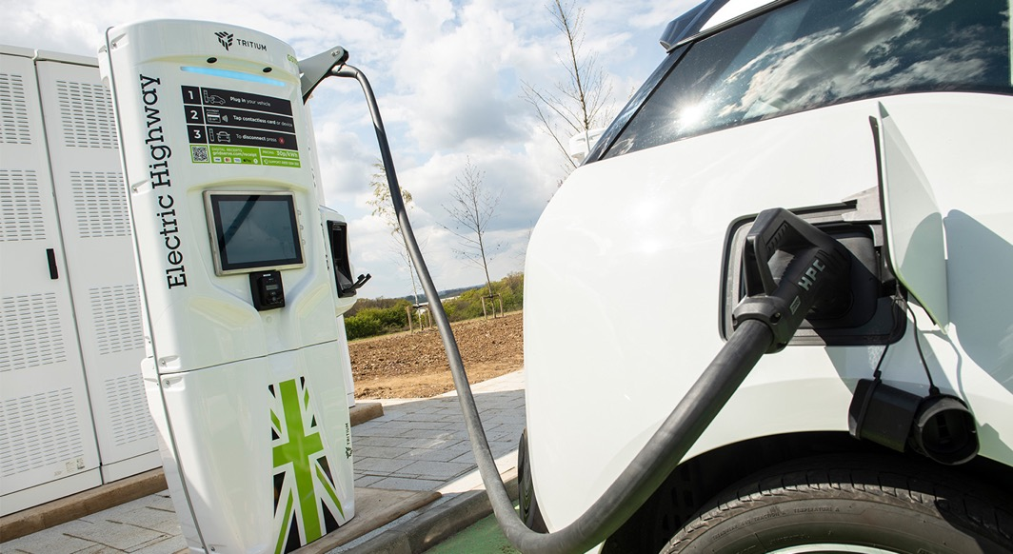
ELECTRIC VEHICLE CHARGING
FREE STANDING POINTS
Combination of all charge points available working with our partners, with billing systems available.
12
12

Slide 13
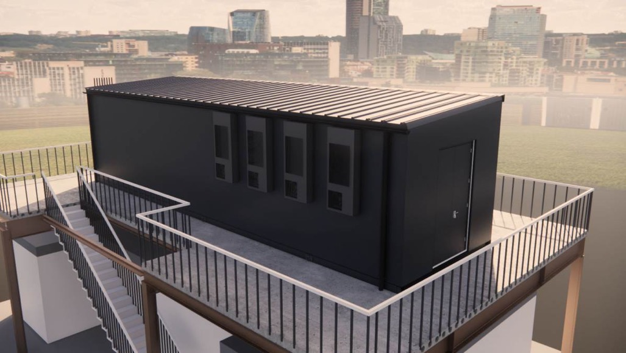

PACKAGE PLANT SOLUTION
ROOFTOP OF GROUND LEVEL
Applications include:
Low Temp Hot Water (LTHW)
Medium Temp Hot Water (MTHW)
Chilled Water (CHW)
Energy Centers
Battery Storage
13
13

Slide 14
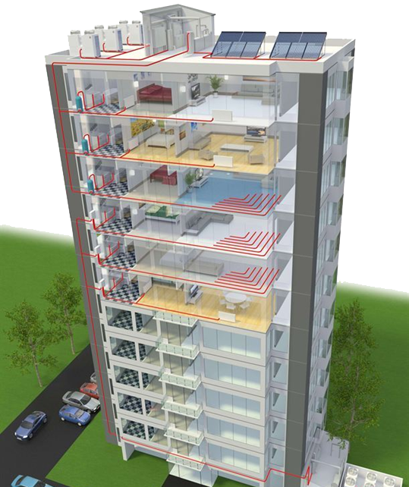
ROOFTOP HYBRID COMMUNAL
WITH HIU AND UNDERFLOOR HEATING
Features and benefits:
Air Source Heat Pumps
Solar PV
Energy Saving Communal areas
Reduced Energy Demand from the Grid
No Radiators taking up space
HIU – removes Gas from the building
14
14
14

Slide 15


A RESIDENT
FOCUSED SERVICE
OUR RESIDENTS MATTER

Slide 16







Residents and leaseholders must be at the heart of everything we do

Slide 17
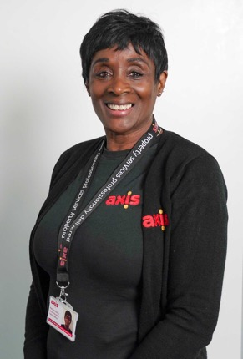

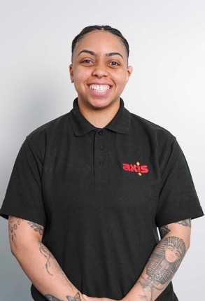

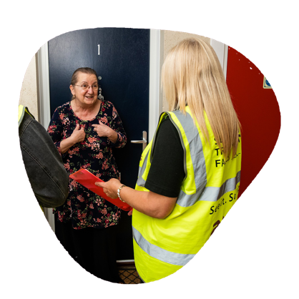
RESIDENT LIAISON TEAM
Our RLOs are your first point of contact and will be onsite when work is taking place
Patricia
Kemeisha
Kemara
…here to answer your questions, help those who need assistance and make sure the work meets resident’s satisfaction

Slide 18


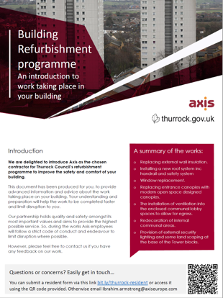
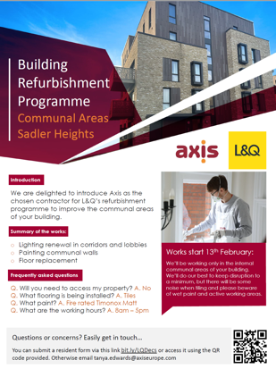
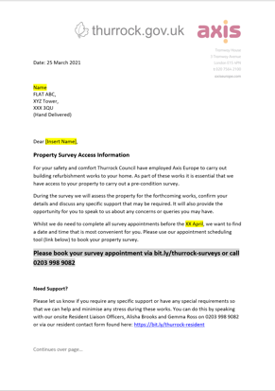

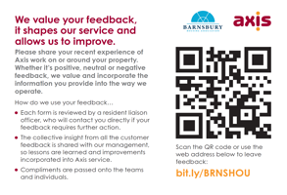
CLEAR COMMUNICATION
We aim to build a close relationship with residents and keep you informed of progress throughout the project.
We have a number of communication tools…
…so you are comfortable with the work taking place around your property
OUR RESIDENTS MATTER

Slide 19

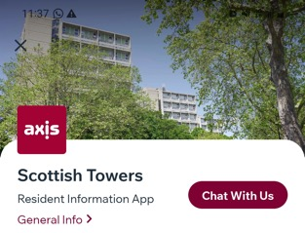
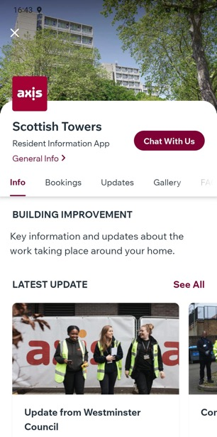


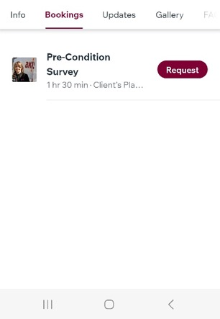
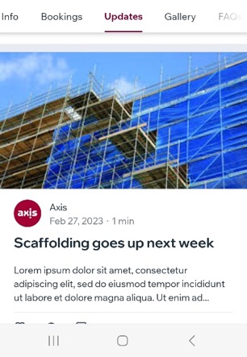
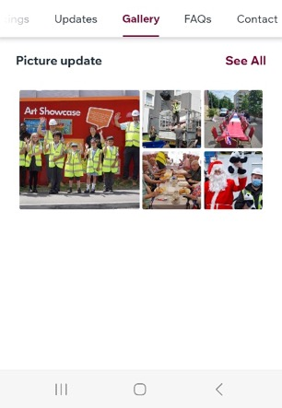
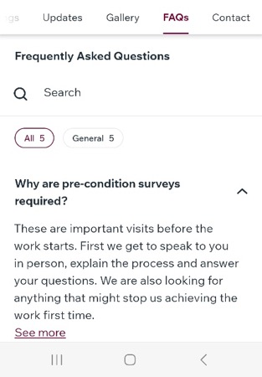





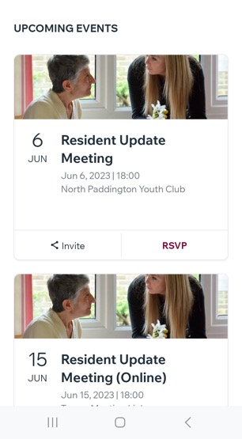
RESIDENT APP
Let’s stay connected…
Receive latest announcements
Find out about resident events
Book appointments
Keep up to date with the project’s progress
See photos of what the team are up to
Find answers to frequently asked questions
Contact the team
…inc live chat (during working hours)
19

Slide 20


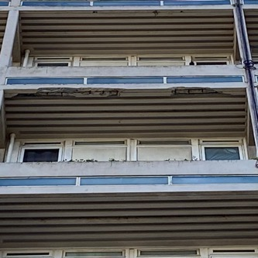

THANK YOU

