Slide 2
Welcome RESIDENTS UPDATE PRESENTATION Emanuel House, 18 Rochester Row, London SW1P 1BS Thursday 30th October 2023

Slide 3
Emanuel House
Agenda
Welcome and Introduction
RAAC (Reinforced Autoclaved Aerated Concrete)
Fire safety
Next steps
Keeping yourselves safe
7:30pm – Meeting to finish

Slide 4
Welcome and Introduction by Claire Nangle
This meeting is to cover just RAAC and fire safety
Meeting to finish at 7:30pm
Questions raised by those joining via Teams will be announced by Holly who will be monitoring the chat forum​
Meeting to be recorded
Please keep to the two item, agenda
Questions at the end
We will record main questions and produce a Q&A which will be posted on the Emanuel House Website

Slide 5
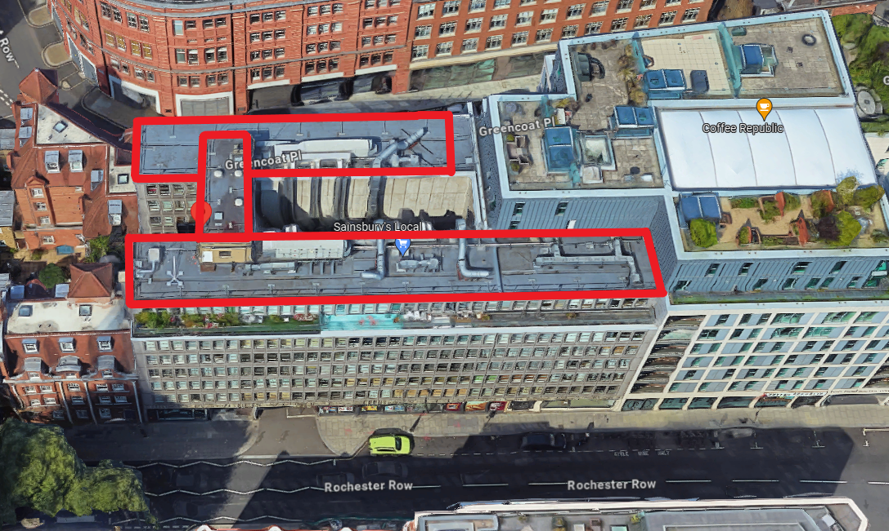
RAAC (Reinforced Autoclaved Aerated Concrete)
Reinforced Autoclaved Aerated Concrete is a form of lightweight concrete used in construction in many buildings between the 1950s and 1990s. RAAC is highly aerated with different material properties to conventional concrete. It is mainly found in roofs, occasionally in floors and walls.

Slide 6
RAAC
Where are we now in terms of knowledge and what are the timescales?
We will need to complete 2 subsequent investigations; a laser levels survey to identify deflection and a reinforcement scan to identify the location and presence of reinforcement. We will also need to inspect the extent and condition of the ends of the panels bearing onto the structural beams. This may require some sections of concrete to be removed. To allow for these investigations all ceilings will need to be removed to the 6th floor. The result of these investigations will determine the remedial solution which will either be full replacement or a permanent propping solution
When will we know the final outcome?
Once the above surveys have been completed. The surveys themselves are anticipated to take approximately 10-12 weeks including ceiling removal and reporting timescales. This is not including the potential need for additional opening up or rerouting of services which would extend this timescale.
What does remediation look like?. Worst and best case?
Best case, permanent propping located in the ceiling void.
Worst case, full replacement of all RAAC panels.

Slide 7
FIRE SAFETY
AOV
Questions from residents supplied through the Residents Association
Fire alarm system
Questions from residents supplied through the Residents Association

Slide 8
FIRE SAFETY
Questions from residents
How did the alarm system get set up as it is?
What should it be?
How will we fix it?
How will we ensure communication on Stay Put is clear?
Why was the autodialler taken away?
When working, need to video a fire test of the AOV and each time it is tested thereafter. The video should then be shown to residents for reassurance.
How often is the fire alarm tested?
What can residents do to make the building safe?

Slide 9
REQUIREMENTS OF LONDON FIRE BRIGADE (LFB)
Management had not planned the preventative and protective measures required for the simultaneous evacuation stated on the fire risk assessment. The fire alarm was not interlinked to the flats from the common parts to allow for a full evacuation.
The maintenance of flat front doors and communal fire doors needed improvement.
The management had not uploaded the fire safety information onto the London Fire Brigade High Rise Portal with regards to plans, external wall information and reporting defects.
Storage of combustible items in the means of escape was not monitored or controlled. There was furniture and old audio equipment outside flat 7.
There was no monitoring or reviewing where wires were passing through walls without any adequate fire stopping. This was evident on the basement level near the storage area for residents.
Wayfinding signage is not present in communal areas in accordance with new Fire Safety Regulations (England) 2022.

Slide 10
REQUIREMENTS OF LONDON FIRE BRIGADE (LFB)
There is no secure information box at present.
Evacuation procedures need to be reviewed with current findings of compartmentation survey.
Flat front doors non-compliant
No servicing for emergency lighting
Training for staff on site in fire safety
Significant findings from the FRA have not been completed as per the timescales given.

Slide 11
NEXT STEPS
Resident engagement updates
How would residents wish to be updated?
Frequency/type

Slide 12
Communication
We would like to keep communication open with all leaseholders and residents, and therefore we have many different ways for you to contact us to discuss as noted below;
Emailing WCC on emanuelhouseproject@Westminster.gov.uk
Phoning FirstPort on 07739317727
Post by hand to Billy and/or Jennie, alternatively you can post via the postal box for flat 6 Emanuel House.
Post to FirstPort office – FAO , Marlborough House, Wigmore Place, Luton LU2 9EX
Emailing the managing agent Jennie Roos Jennie.Roos@firstport.co.uk
Visiting the Website https://www.westminster.gov.uk/emanuel-house-proposed-major-works-cwg13297/documents
The Website will be updated with FAQ’s.
For those of whom who are not online, Jennie Roos or Billy can assist in showing you the Website at Emanuel House.
We will also be holding regular residents meetings which you will be notified of once arranged.

Slide 13
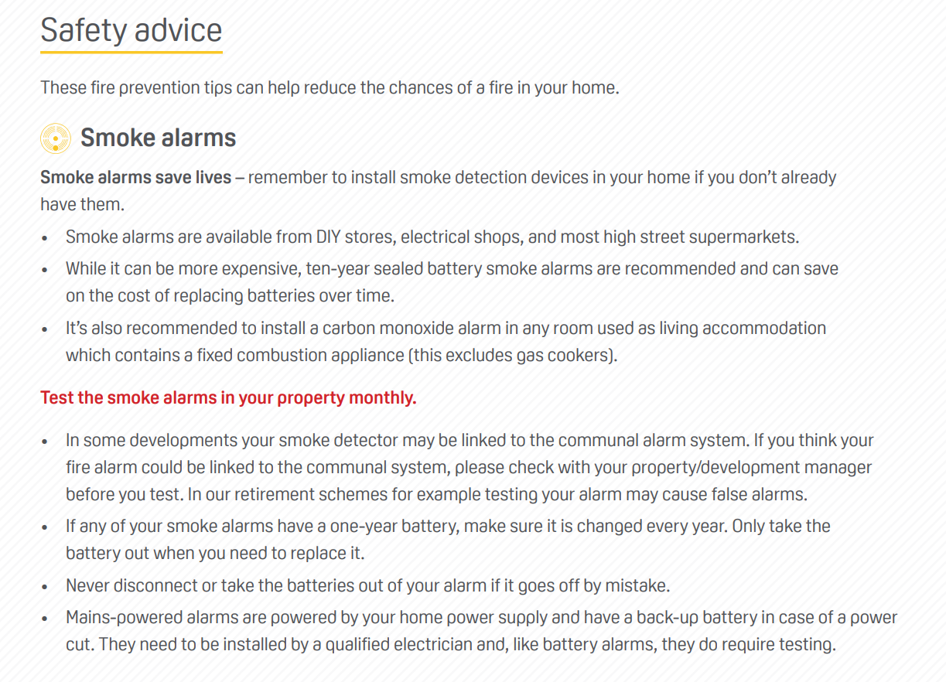
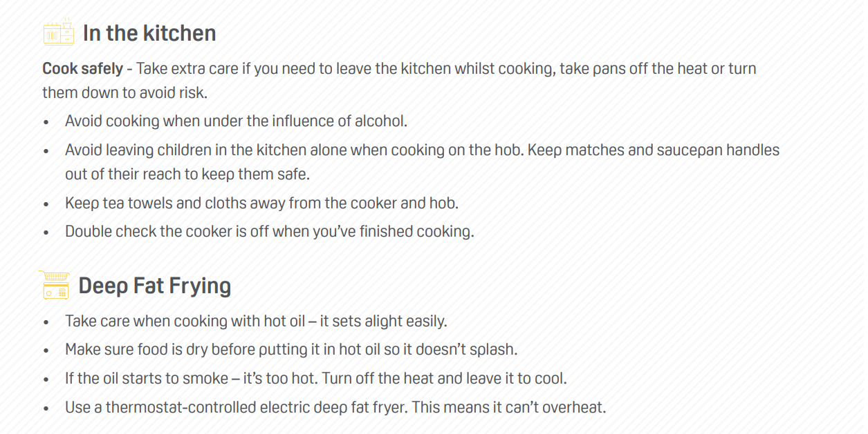
STAYING SAFE

Slide 14
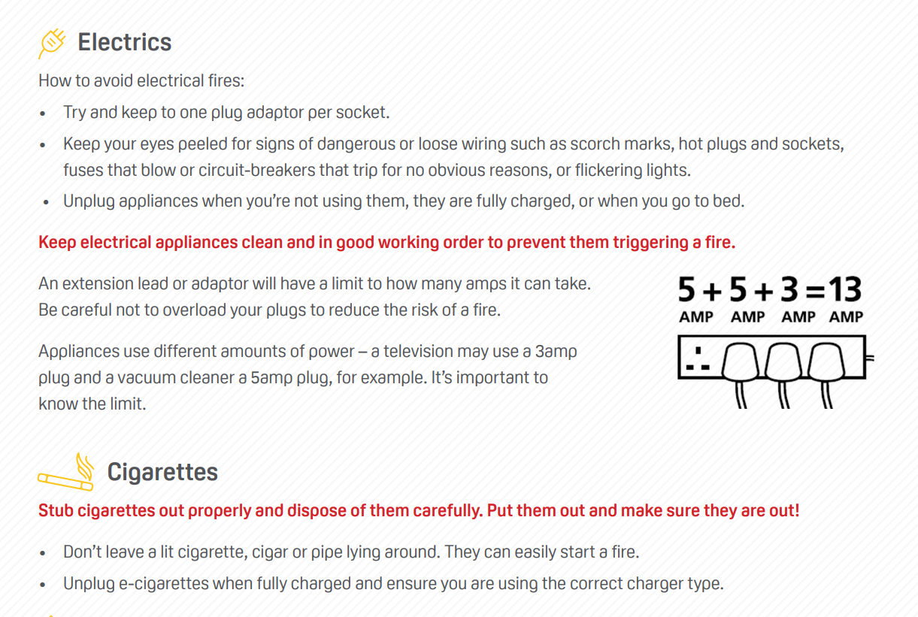
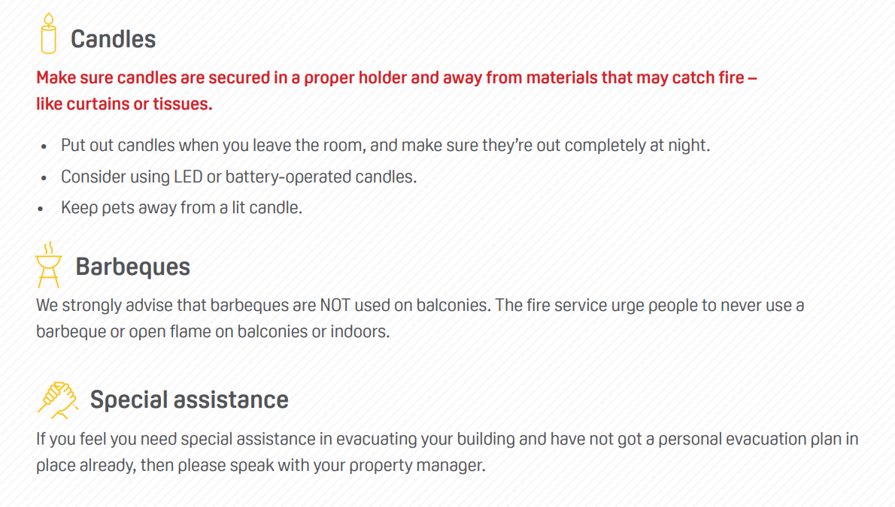
STAYING SAFE

Slide 15
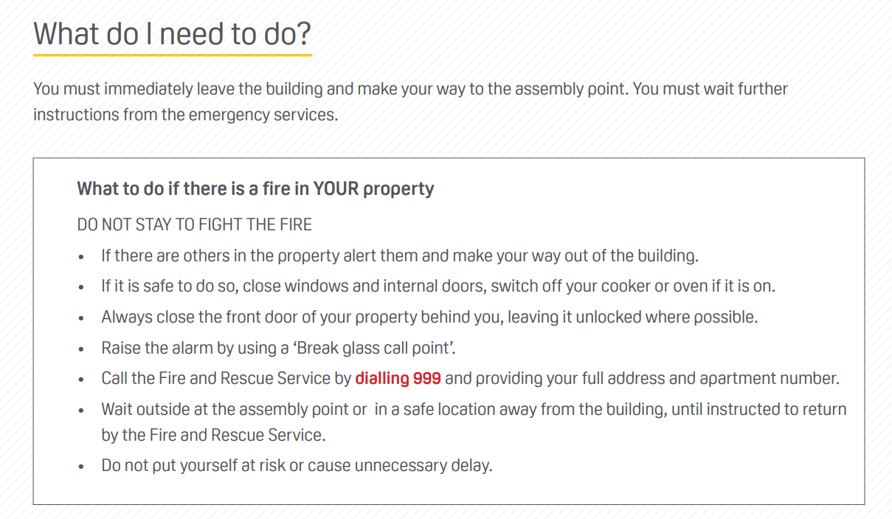
STAYING SAFE

Slide 16
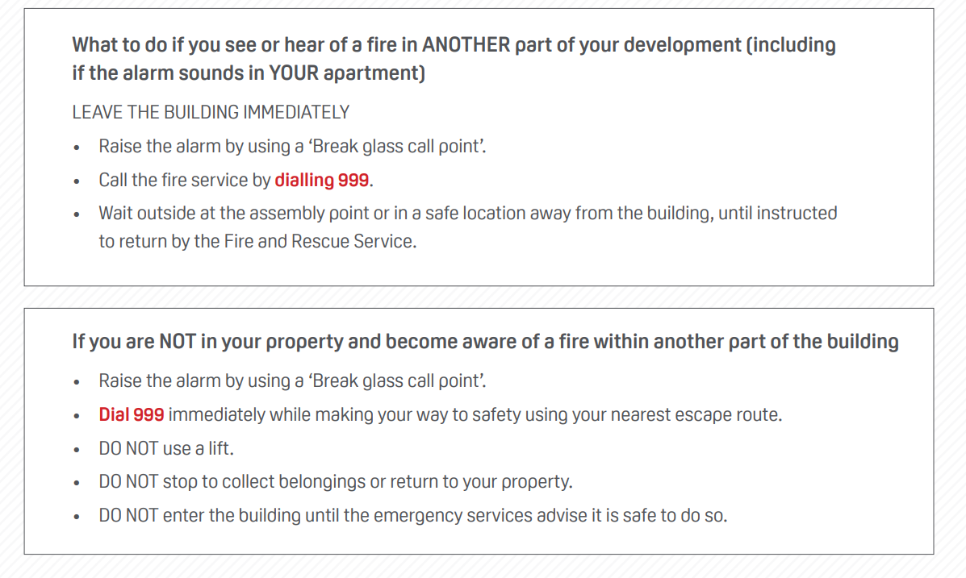
STAYING SAFE

