Slide 2
Welcome RESIDENT UPDATE PRESENTATION Emanuel House, 18 Rochester Row, London SW1P 1BS Tuesday 25th July 2023

Slide 3
Emanuel House – Resident Update Presentation
Agenda
Welcome and Introduction
Update from meeting of 9th May 2023 regarding proposed major works with leaseholders
Offer of sale of the Freehold
Major Works Project Plan
Fire Safety
7:30pm – Meeting to finish

Slide 4
Emanuel House – Resident Update Presentation
1. Welcome and Introduction by Kevin Dey
Introduction to WCC/Blenheims.
Housekeeping;
Meeting to finish at 7:30pm.
Questions raised by those joining via Teams will be announced by Holly who will be monitoring the chat forum.
Meeting to be recorded.
Please keep to the agenda.
Mutual respect.
Questions at the end.
We will record main questions and produce a Q&A which will be posted on the Emanuel House Website

Slide 5
Emanuel House – Resident Update Presentation
2. Update from meeting of 9.05.2023 regarding proposed major works with leaseholders
Subsequent to the last meeting, all homeowners were provided with the meeting minutes and a copy of the questions and answers received from the Residents Association.
The timeline has shifted slightly and is shown below;
Specification drafted Autumn 2023
Contract to be signed Spring 2024
Potential works to start Summer 2024
During each of these stages we will be updating leaseholders, which includes todays meeting.

Slide 6
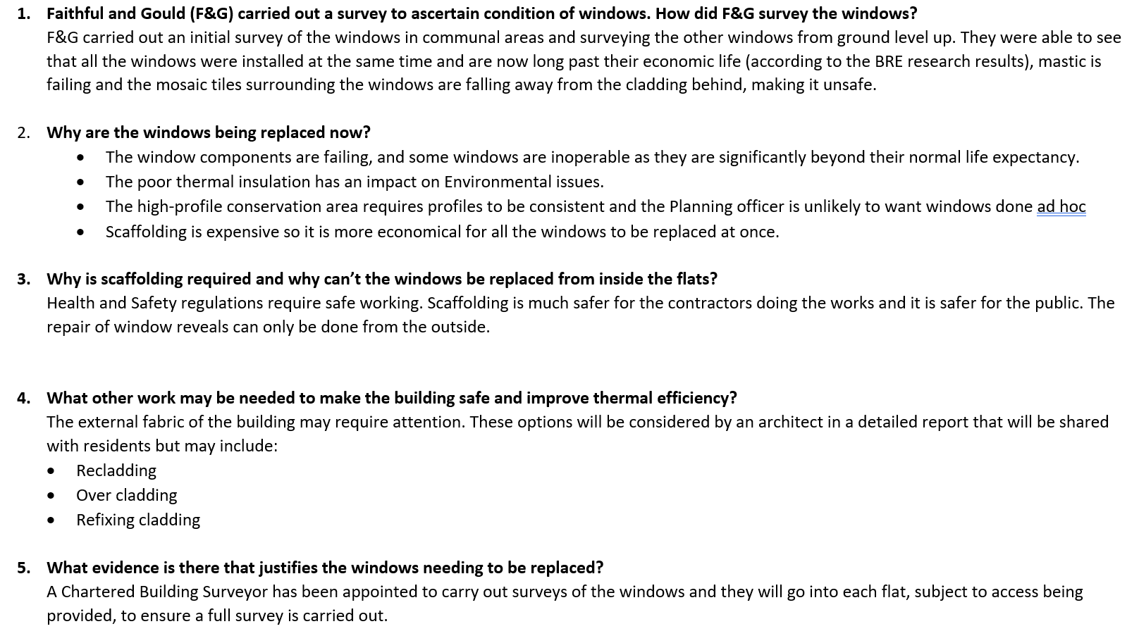
Emanuel House – Resident Update Presentation
2. Update from meeting of 09.05.2023 regarding proposed major works with leaseholders
The frequently asked Questions are on the website https://www.westminster.gov.uk/emanuel-house-proposed-major-works-cwg13297/documents and Answers are listed below;

Slide 7
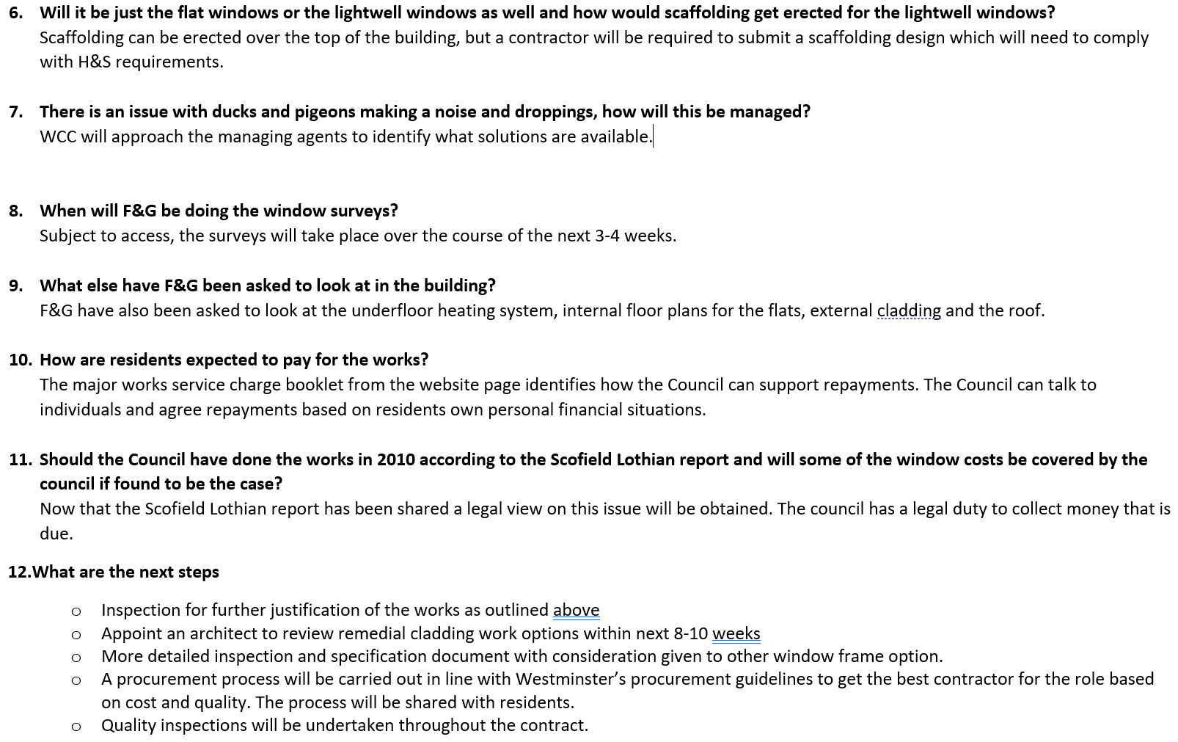

Slide 8
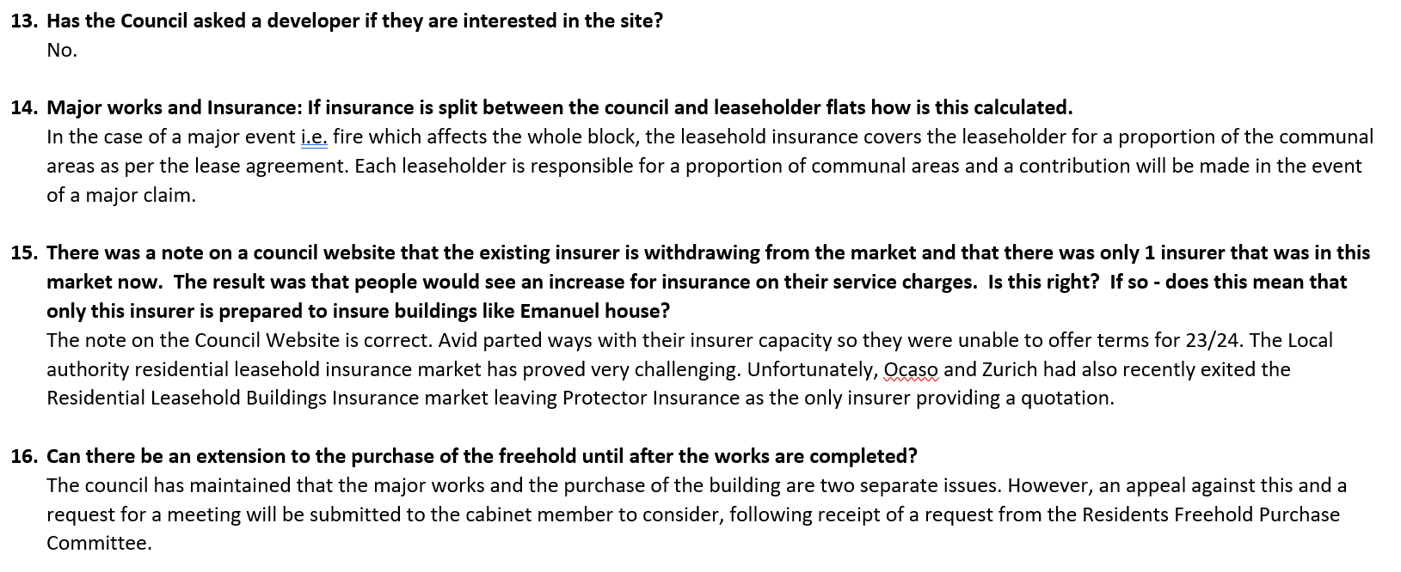

Slide 9
Emanuel House – Resident Update Presentation
2. Continued Update from meeting of 09.05.2023 regarding proposed major works with leaseholders
We would like to keep communication open with all homeowners on the proposed works, and therefore we have many different ways for you to contact us to discuss as noted below;
Emailing WCC on emanuelhouseproject@Westminster.gov.uk
Phoning 07739317727
Post by hand to Billy and/or Jennie, alternatively you can post via the postal box for flat 6 Emanuel House.
Post to Blenheims office – FAO , Marlborough House, Wigmore Place, Luton LU2 9EX
Emailing the managing agent Jennie Roos Jennie.Roos@blenheims.co.uk
Visiting the Website which is now live, please visit https://www.westminster.gov.uk/emanuel-house-proposed-major-works-cwg13297/documents to view this. The Website will be updated with FAQ’s along with meeting minutes should you be unable to attend a meeting.
For those of whom who are not online, Jennie Roos or Billy can assist in showing you the Website at Emanuel House.
We will also be holding regular residents meetings which you will be notified of once arranged.

Slide 10
Emanuel House – Freehold Purchase
3. Offer of sale of the Freehold

Slide 11
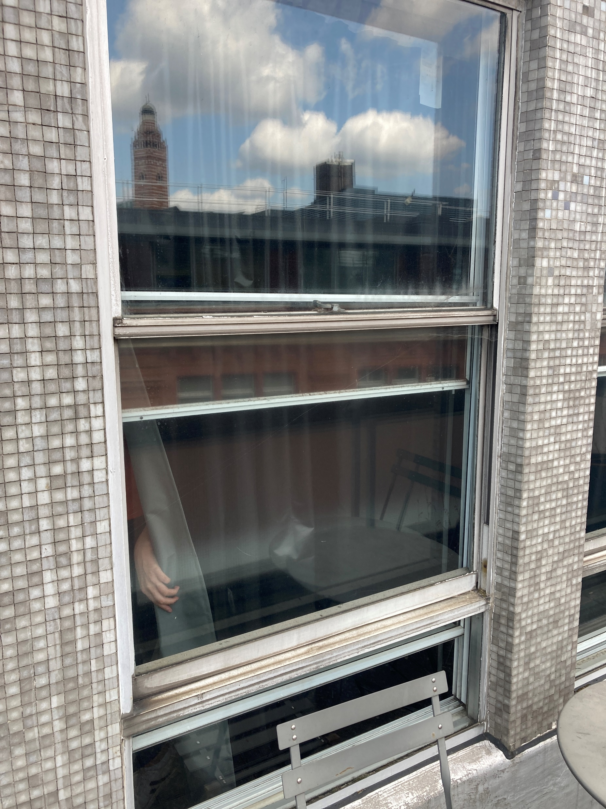
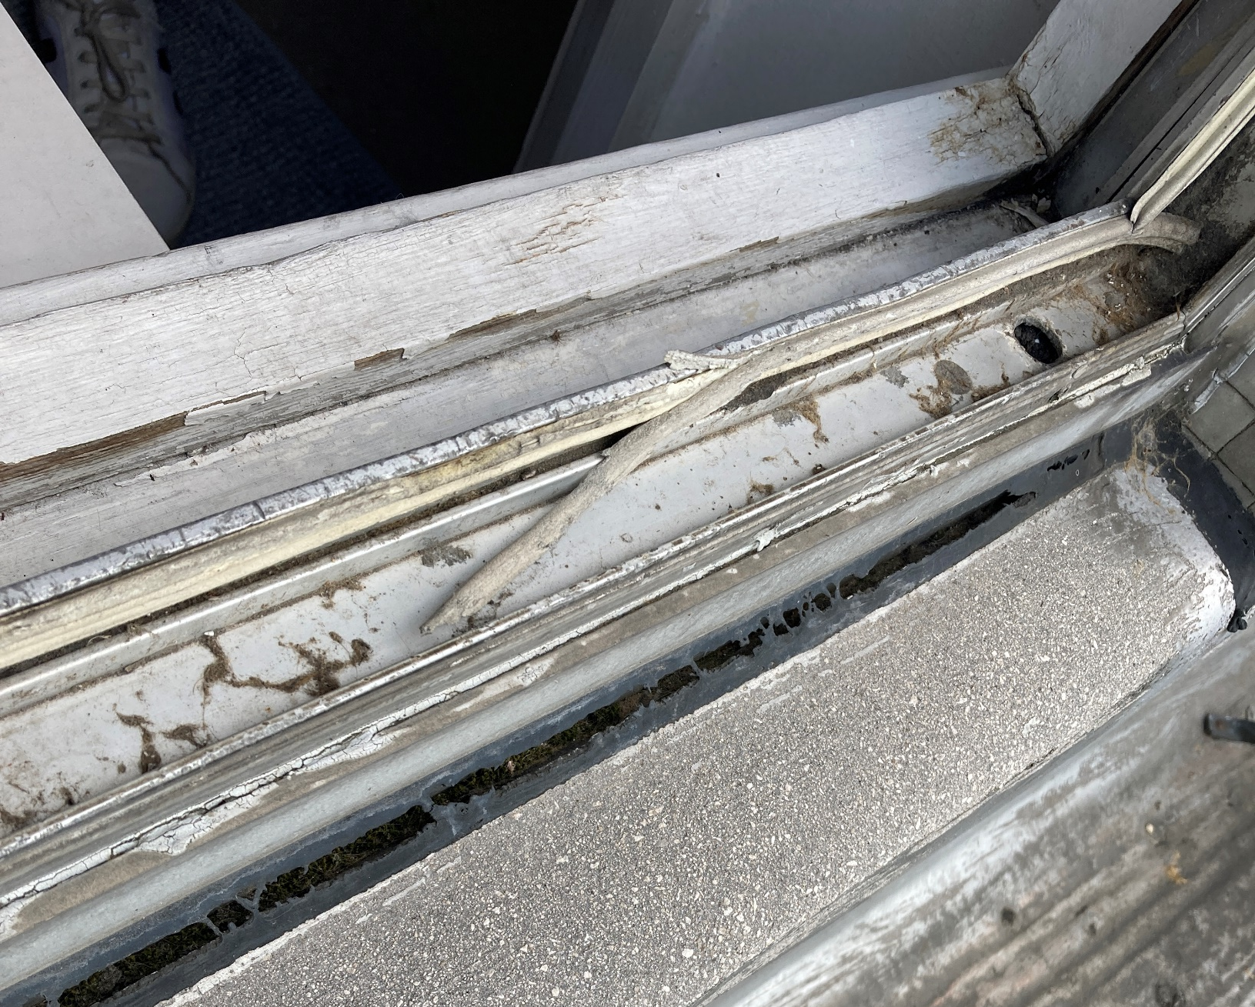
Emanuel House – Major Works
4. Major Works Project Plan
Window survey has found condition is consistent across the building after gaining access to 32 flats on various elevations of the building
The Windows are at end of life and need replacement
Façade options
Update from Chris Barnard (Building Surveyor)

Slide 12
Emanuel House
5. Fire Safety

